Slide 1
Joyful server-side full stack web development with Spring ViewComponent
Thomas Schuehly
9th August 2023
Notes:
Hello and welcome to my talk, joyful server-side full stack web development with Spring ViewComponent.

Slide 2

Thanks to JavaLand for sponsoring this talk!
Notes:
Thanks to JavaLand for sponsoring my talk

Slide 3
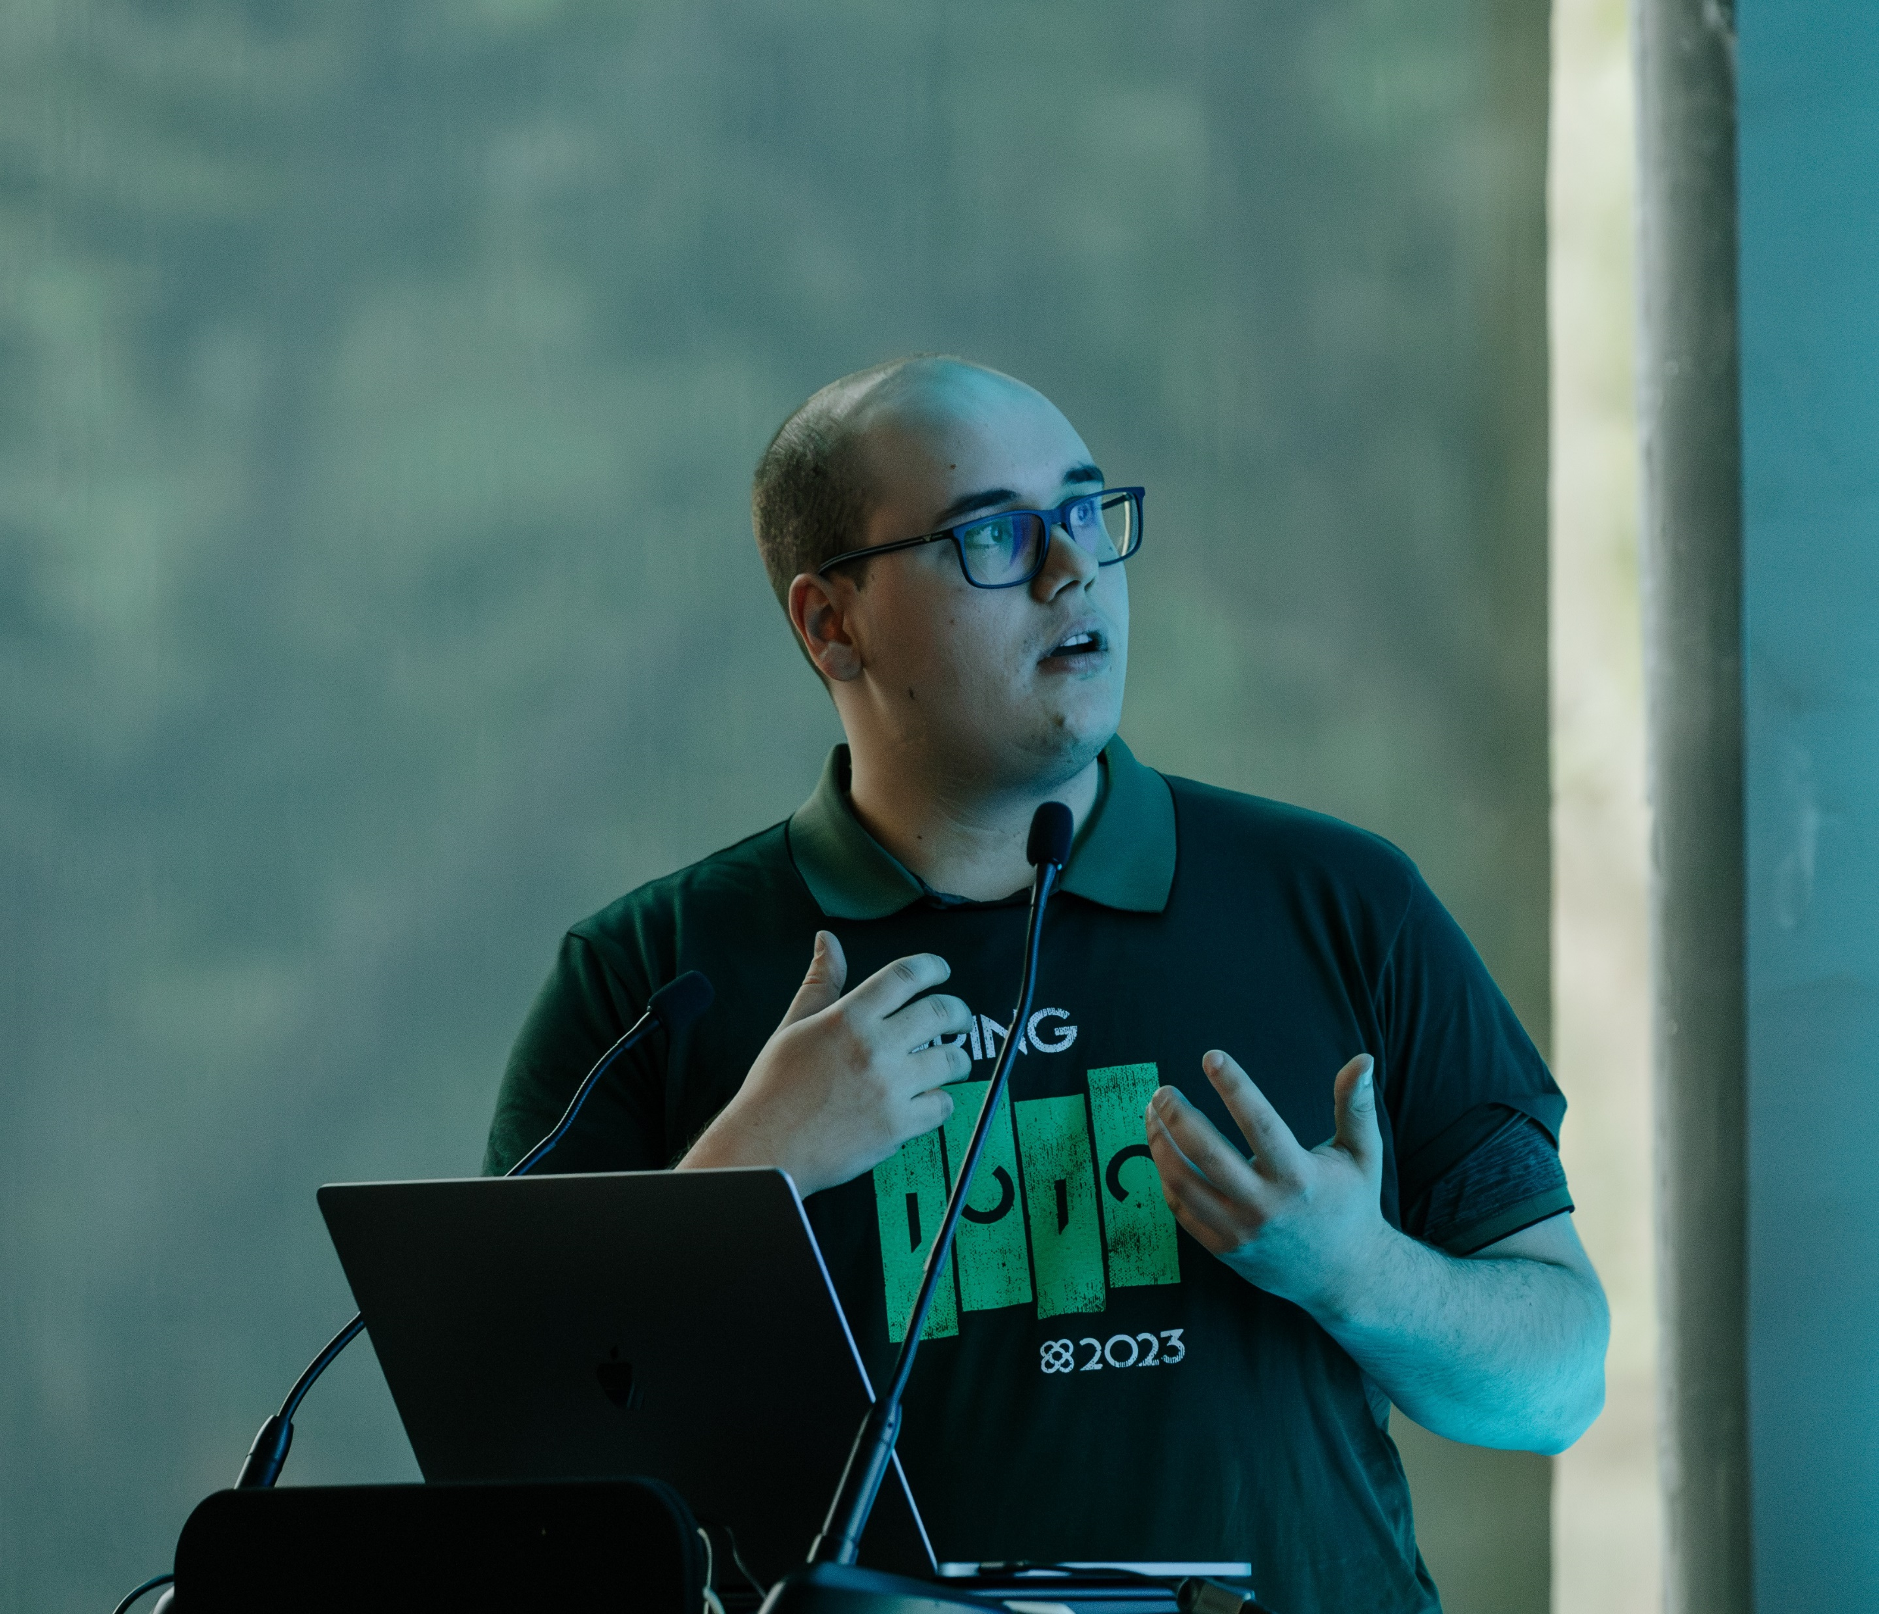
Thomas Schühly
Spring Boot + Kotlin = ❤️
Blogging on tschuehly.de
Freelance Web Developer
Open-Source Developer:
github.com/tschuehly/spring-view-component
github.com/tschuehly/supabase-security-spring-boot-starter
Process Automation Software Engineer @mimacom Germany
Notes:
I’m excited to be here as this is my first Java User Group, thanks to Frederik for inviting me. My name is Thomas Schühly, I’m 23 years old and passionate about building awesome software with Spring Boot and Kotlin.
I’m blogging about my experiences at tschuehly.de.
After hours I am working on two Open Source Libraries. Spring ViewComponent and the Supabase Security Spring Boot Starter I’m also working as a Freelance Web Developer for smaller clients. To keep me from working to much on my open-source stuff I currently work as a Process Automation Software Engineer at Mimacom Germany.
So much for the intro!
To get started I want to ask you a Question!

Slide 4
Would you describe yourself as a Software Engineer?

Slide 5
Software Engineering
Notes:
Most of you are Software Engineers, I assume all of you know what the Software part is

Slide 6
Software Engineering
Notes:
But have you thought about the Engineering part? What is Engineering and how should it affect us when developing and designing modern software applications?

Slide 7
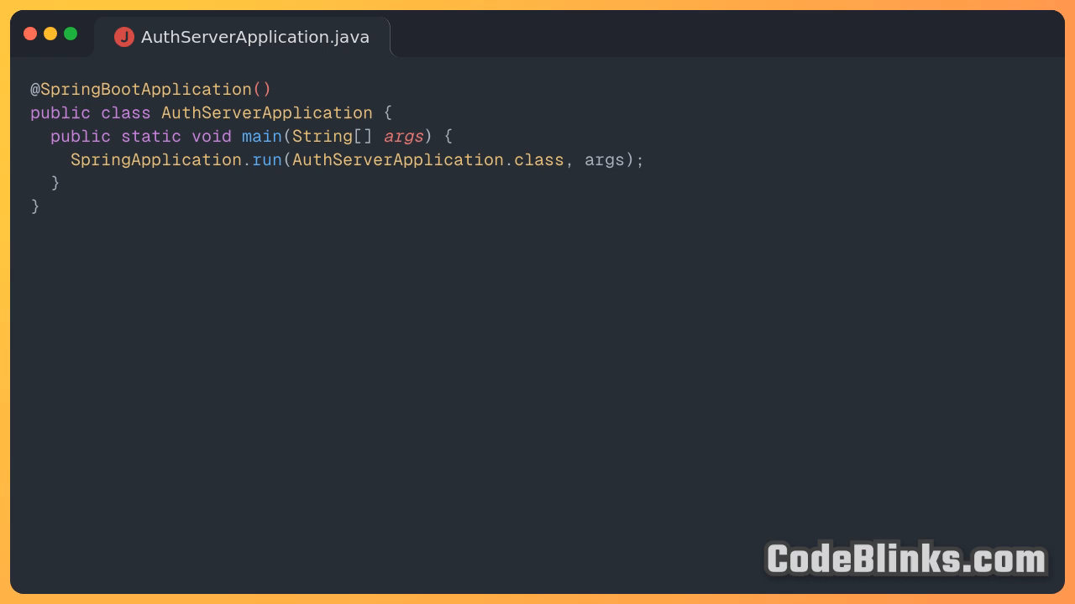

Slide 8




https://www.davefarley.net/
https://www.youtube.com/@ContinuousDelivery
Notes:
I neither have the experience nor the aspiration to teach you much about Software Engineering. I’ve been only a Software Engineer for a few years.
This is why I am drawing upon the insights of Dave Farley, an expert in Continuous Delivery, he co-authored the pioneering book “Continuous Delivery” establishing a practice which has become industry standard.
He also has a long track record in creating high-performance teams and outstanding software.
As a Software Engineer, I have always looked up to him for his valuable insights and his real world experience.
He shares his insights on his YouTube channel, Continuous Delivery.
His practical approach to Software Engineering, rooted in real-world experience, makes his insights very valuable for me.

Slide 9
Engineering
„Stifling Bureaucracy and heavy weight process control“
„Simply writing code and nothing else“
Dave Farley
What is Modern Software Engineering?
Notes:
He shares his point of view about Engineering in his blogpost “What is Modern Software Engineering”
He is uneasy with the term “engineering” in the context of Software Development, as it was either incorrectly loaded with meaning or emptied of it all together.
Some developers believe that "engineering" entails oppressive bureaucracy and excessive process control, while others believe that "engineering" only involves writing code and nothing else."

Slide 10
“In other disciplines, Engineering is simply the stuff that works. It is practical, pragmatic and more, not less, efficient.”
Dave Farley
What is Modern Software Engineering?
Notes:
He tells us that both of these are profoundly wrong. In other disciplines, “Engineering” is simply the stuff that works.
It is practical, pragmatic and more, not less, efficient.”
But the question I want to discuss today: Is the way we build modern web applications “practical, pragmatic and efficient?”
Could there not be a simpler approach that is sufficient for many use cases?

Slide 11
“The systems that modern engineers create are increasingly complex and sophisticated, [ .. ] modern software engineering, needs to focus us on managing that complexity”
Dave Farley
What is Modern Software Engineering?
Notes:
He continues:
“The systems that modern engineers create are increasingly complex and sophisticated.
Modern software engineering, needs to focus us on managing that complexity”
Farley concludes that, if an engineering approach to software development doesn’t help us to create better software faster, then it’s wrong and doesn’t qualify as “Engineering”.

Slide 12



Notes:
Did we overshoot this goal while trying to build more advanced systems than ever before to solve the problems that we created ourselves?
What if instead we took a step back and tried to reduce the complexity of our modern web applications that is not inherent in the challenges of our business domain, but accidental due to the nature of our solutions.

Slide 13
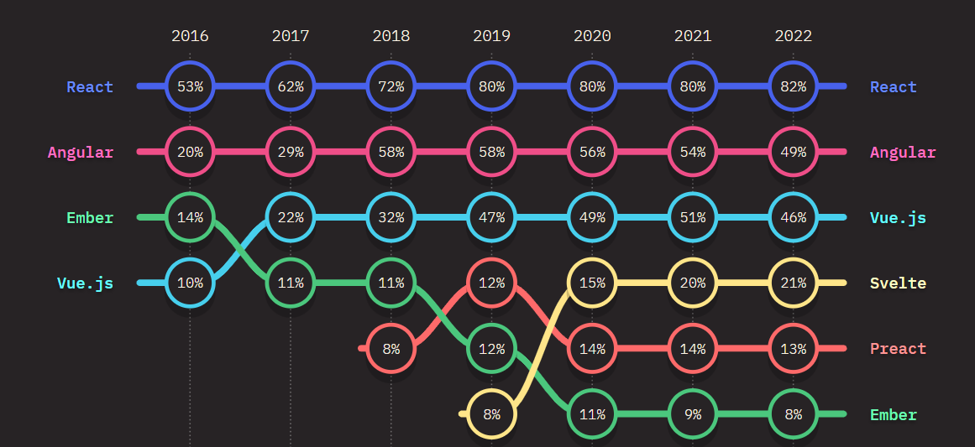
FRONT-END FRAMEWORK USAGE OVER TIME
Notes:
Modern JavaScript Frameworks were developed to manage the complexity of front-end web development and to improve the User and Developer Experience.
They are mostly Single Page Applications, meaning a Blank HTML Page with a big blob of JavaScript is delivered, which then takes over the Render Process.
The most used JavaScript Framework is React, in the 2022 State of JavaScript Survey 82 percent of Developers reported that they use it.
It has grown over the last decade to the de facto norm for building web frontends.

Slide 14
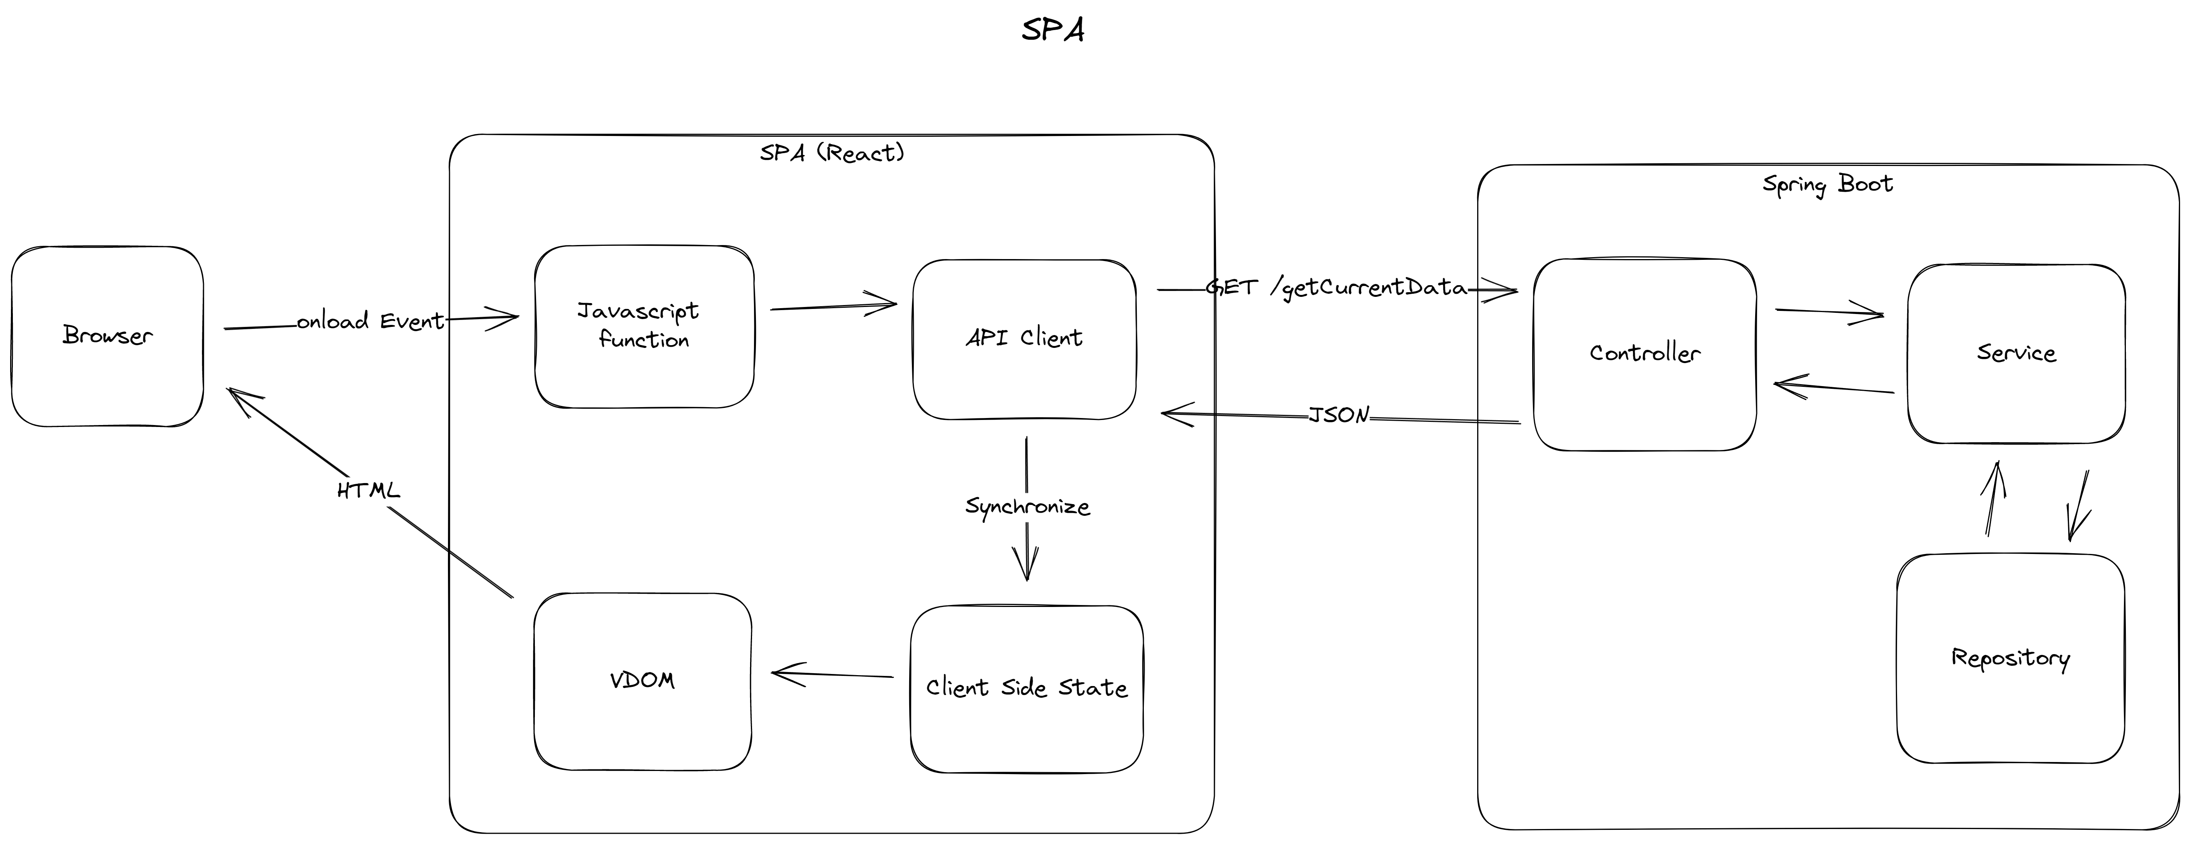
Single Page Application
Notes:
What you see here is the typical render path of an SPA that is displaying some data from our Spring Boot Backend.
You have the Browser that calls a JavaScript Function, typically a component.
Then this function calls an API Client to get the Server Side Data from the Backend.
The Backend fetches the Data and transforms it into Plain Old Java Objects, then Jackson transforms the objects into a JSON representation.
The JavaScript API Client then parses the JSON Data back into JavaScript Objects.
These needs to be synchronized with the current Client Side State stored in other JavaScript Objects.
Then the SPA merges the changes into a Virtual Dom and then that Virtual DOM needs to be synchronized with the actual HTML Browser DOM.

Slide 15
After years of relative stability, many are now beginning to question the status quo. [..] on the server Astro, Remix and Next.js (among others) are making us reconsider how much code we really need to ship to the client.”
State of JS 2022
https://2022.stateofjs.com/
Notes:
The JavaScript community themselves started to question the way modern web applications were built over the last decade.
The Introduction to the State of JS Survey 2022 reads:
[ZITAT]

Slide 16

Do we need the complexity of “modern” JavaScript frameworks for building on the web?
Notes:
But if even the JavaScript Fanboys are telling us that we shouldn’t ship much code to the client
why do we need all the complexity that all these JavaScript frameworks come out of the box?
There are certainly use cases where you need sub millisecond response times on a dynamic UI.
But does anyone think that all the stuff currently built with an SPA needs an SPA from a User Experience standpoint?

Slide 17
There is a sweet spot of React: in moderately interactive interfaces. Complex forms that require immediate feedback, UIs that need to move around and react instantly.”
Tom MacWright
Second-guessing the modern web
https://macwright.com/2020/05/10/spa-fatiguehtml
Notes:
Tom MacWright puts it nicely in his blogpost “Second Guessing the modern web”.
ZITAT
I agree that there are many applications that need this level of user experience.
But I would argue that even more applications, don’t need this level of interactivity across the whole application and could benefit from a simpler approach.

Slide 18
Single Page Applications are an architectural style
Tradeoffs analysis are skipped
Many Websites will benefit from the simplicity of server-side logic
thoughtworks Technology Radar Vol. 27
www.thoughtworks.com/content/dam/thoughtworks/documents/radar/2022/10/tr_technology_radar_vol_27_en.pdf
Notes:
The excellent engineers contributing to the thoughtworks technology Radar 2022 agree. Single Page Applications are an architectural style.
Your team should choose an SPA approach after a proper analysis of the tradeoffs involved like the additional complexity an SPA incurs.
But the problem is that too often this trade-off analysis is skipped, and it is not evaluated if the business or user experience requirements need a framework like React.
Many developers are not aware of the possibility of another way of doing things because they spent their entire career, in a framework like React.
The thoughtworks Technology Radar concludes that “many websites will benefit from the simplicity of server-side logic”.
And today I will show you how we can get an awesome developer and user experience with a technique first described in the year I was born by a certain Roy Thomas Fielding.

Slide 19
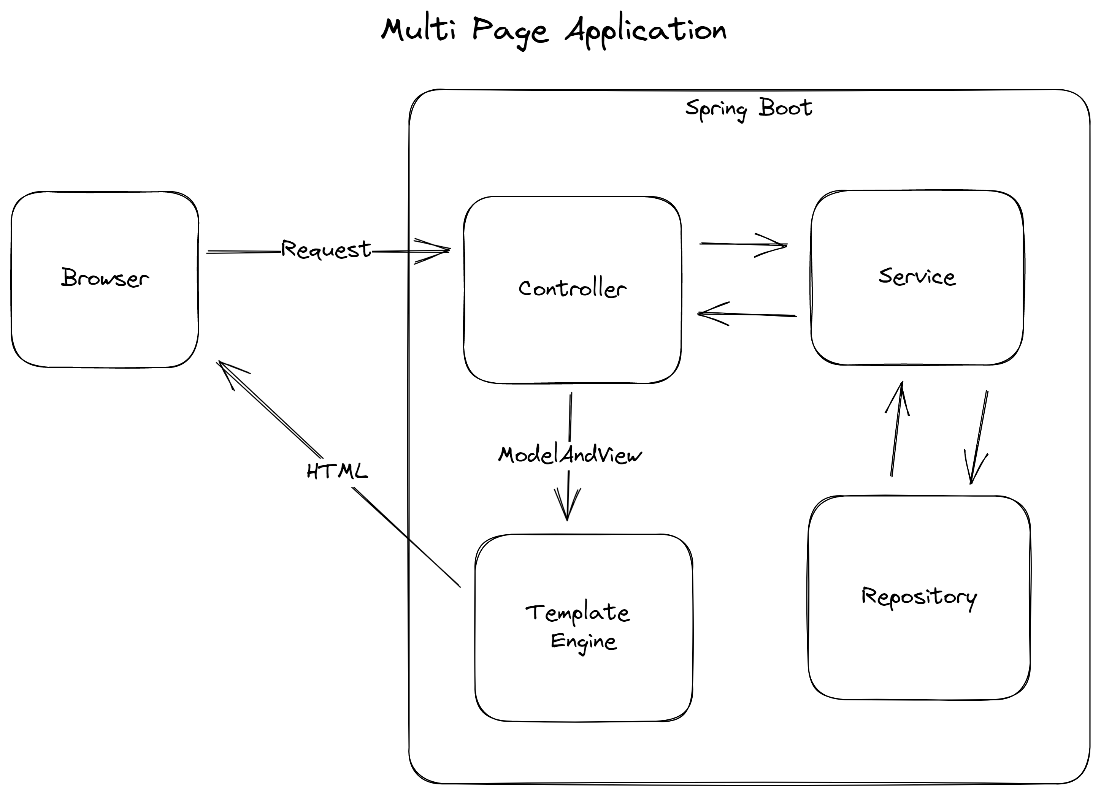
Notes:
Most of you that were developers before 2015 probably build web apps with the traditional approach to the web, Multi Page Applications.
The approach is quite simple and still powers most of the web today.
Instead of shipping a giant JavaScript bundle to render the page on the client, we just ship the HTML the browser can display directly from our Server, thus having no overhead.
Spring Boot itself can serve HTML directly from any endpoints. The browser creates a Request to a Controller Endpoint.
After retrieving the data from our database we pass the data as model and the HTML Template as view to a template engine.
The template engine renders the view and model to html and returns it to the browser.

Slide 20
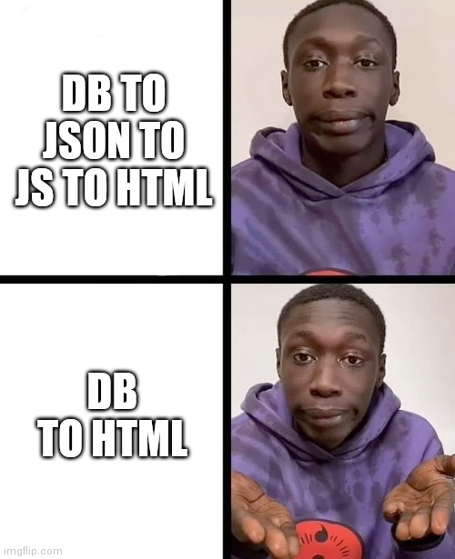
Notes:
Sounds awesome right? We removed a whole lot of complexity, because we removed two data representation layers between our client and our data.
But we lost a whole lot of interactivity as we currently send static HTML without any client-side JavaScript to our user.
How can we return interactivity to our Server Rendered HTML?

Slide 21
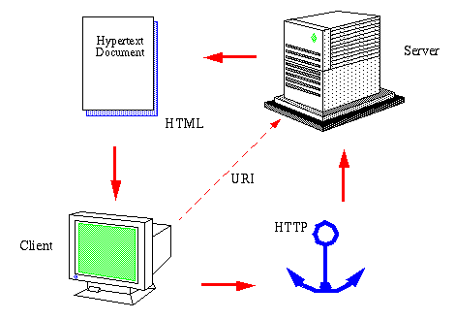
The World Wide Web
Henrik Frystyk
July 1994
https://www.w3.org/People/Frystyk/thesis/WWW.html
Notes:
To solve this question, we need to focus back on the original model of the world wide web and focus on the Hypermedia essential to even the most over engineered JavaScript web-apps.
Because in the end the browser can only display the Hypertext Markup Language.
So why not deliver HTML directly on the Hypertext Transfer Protocol like Tim Berners Lee did in 1989 when he invented the World Wide Web.
Hypertext is a form of Hypermedia. Ask your younger colleagues if they ever heard of Hypermedia! Not many tutorials cover the fundamental platform of the World Wide Web.

Slide 22
Hypermedia is defined by the presence of application control information embedded within, or as a layer above, the presentation of information.
Roy Fielding
Architectural Styles and
the Design of Network-based Software Architectures
Notes:
“Hypermedia is defined by the presence of application control information embedded within, or as a layer above, the presentation of information.”.
What is Fielding telling us with this quite academic definition?
When delivering Hypermedia to your client, you also deliver the possible application interactions the client can exectute.
The most common html hypermedia control is an anchor tag, that can define hyperlinks.
It enables you to discover the whole web applications without needing any documentation.

Slide 23
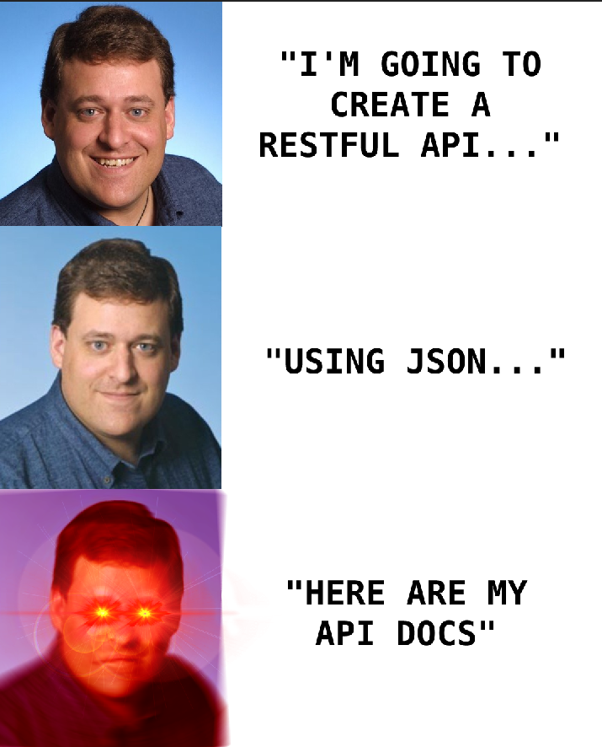
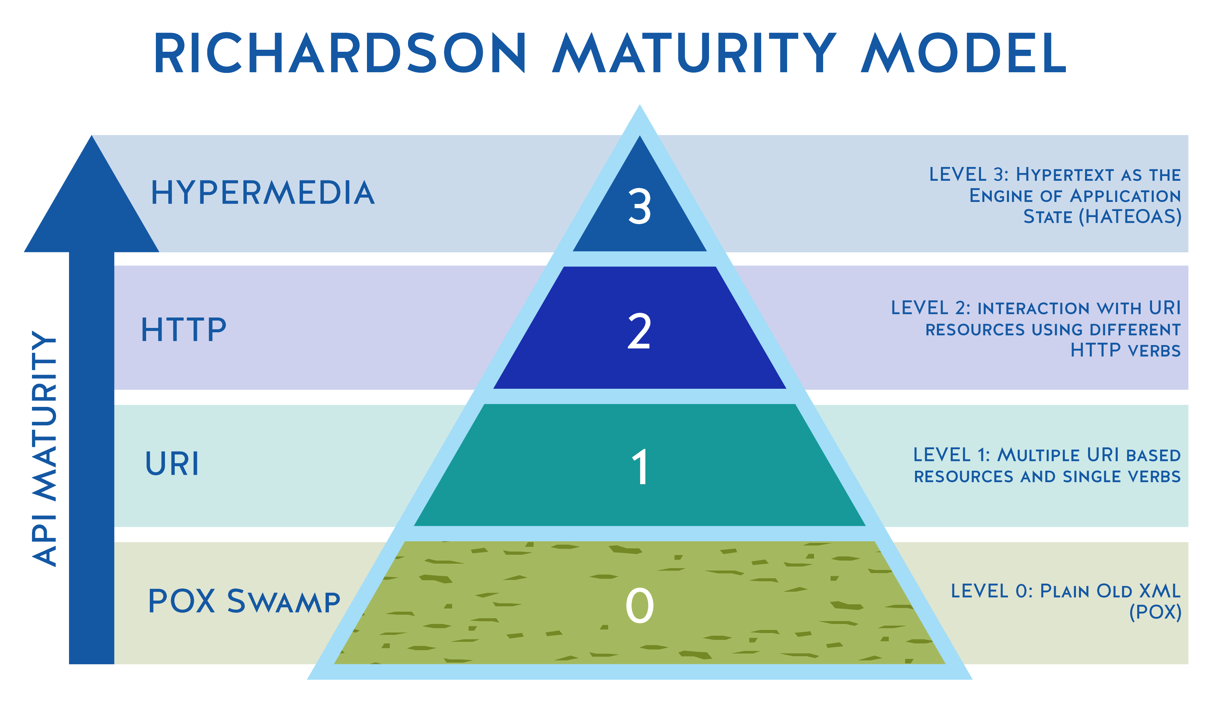
HATEOAS
The forgotten part of REST
Notes:
Hypermedia as the Engine of Application State (HATEOAS) is a constraint of the REST application architecture and is the highest level of the Richardson Rest Maturity Model.
I reckon most REST APIs nowadays are only a level 2, which means using URI resources and different HTTP verbs like get, post, put.
With Level 3, HATEOAS, the client interacts via the server provided information dynamically through hypermedia.
A REST client needs little to no prior knowledge about how to interact with an application beyond a generic understanding of hypermedia.
HATEOAS decouples client and server at the network level, enabling the server to evolve independently from the client, as the server provides both the data and how to act on the data.

Slide 24
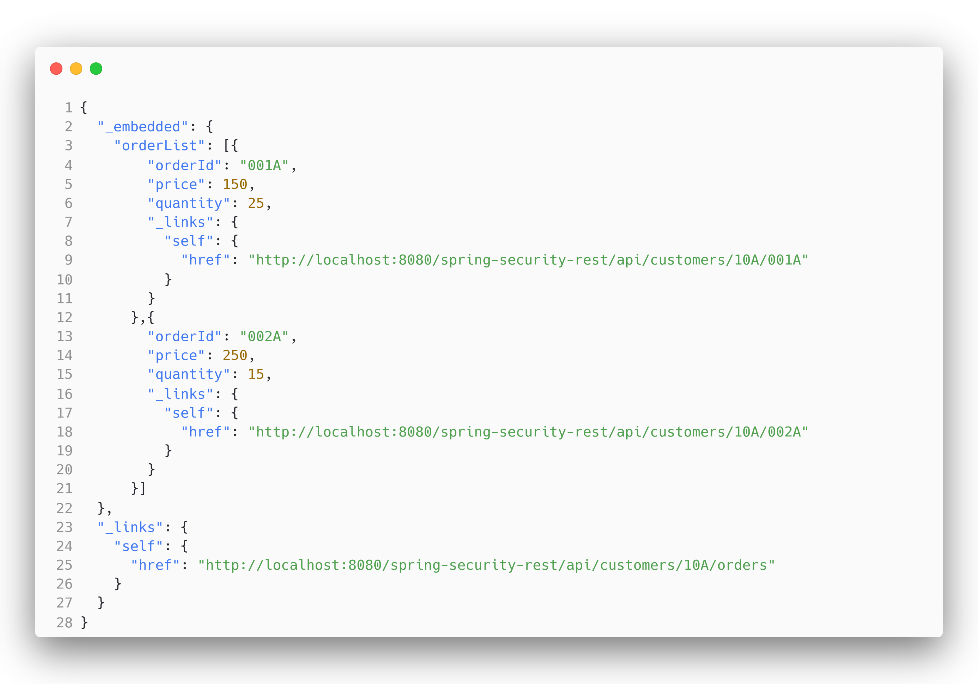
Notes:
You might have heard of the Spring HATEOAS project, which commonly uses a form of JSON Hypermedia representation.
This is great for API discoverability, but it doesn’t really decouple the frontend from our backend in a web browser-based application, as we split the presentation and the Hypermedia.
Our JavaScript based frontend needs to know already that there is a link of this type and how render it into the browser.
You still need a lot of communication between your Frontend and Backend team through API docs to evolve your Single Page Application!
But why do we decouple at the application level between the html templates and the data provider via JSON?

Slide 25
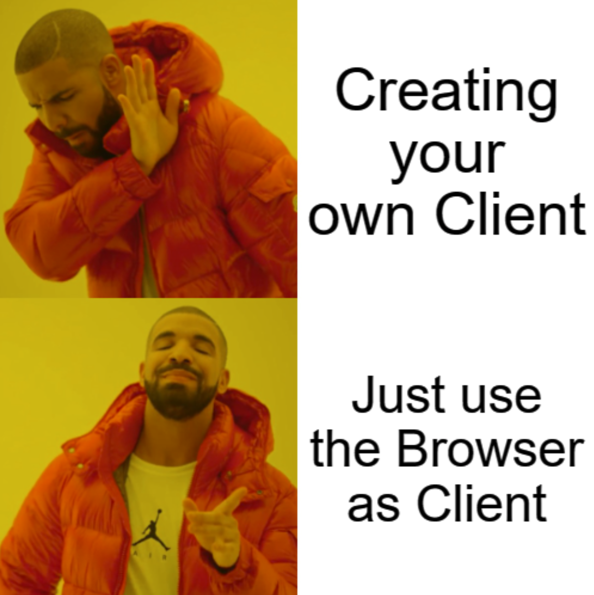
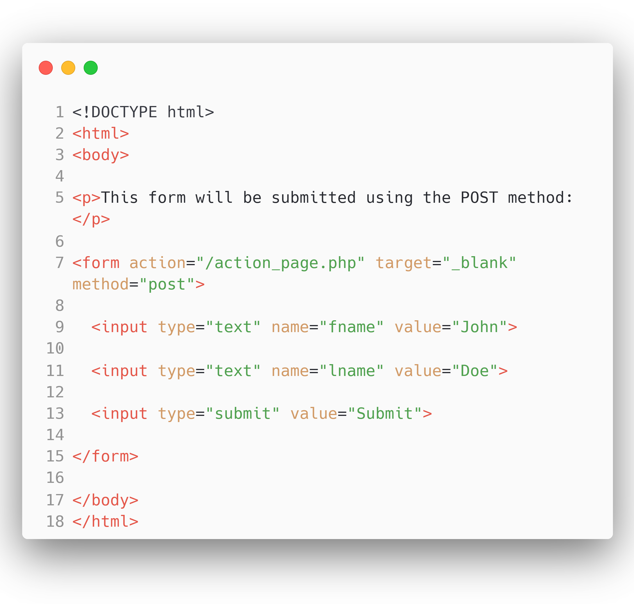
Notes:
We need to literally rebuild the HATEOAS client every user has on his machine by shipping a multi megabyte JavaScript file to the client?
Instead of offering a JSON API to render the templates on the client we will just send the HTML templates fully rendered on the server to our client.
Including the interactions, which makes it a mature REST API with HATEOAS.
You might remember the html on the right! Our browser can make HTTP requests by itself without any JavaScript with the form action attribute!
We don’t need a separate client and server team as we don’t try to rebuild browser functionality and instead just leverage the software our user has on his machine anyway!
We reduce the complexity immensely and enable developers to create features fully by themselves.

Slide 26


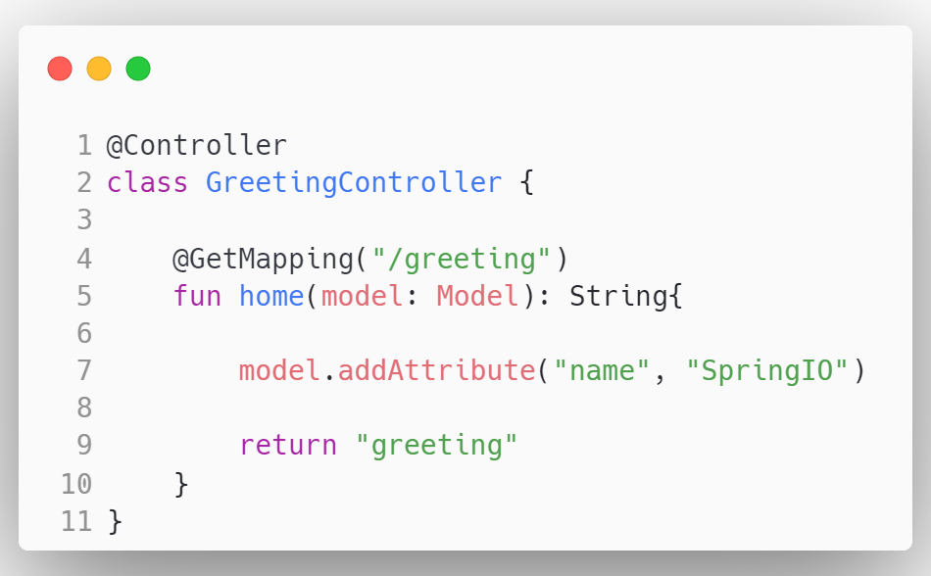
Notes:
But how do we fill the HTML with the data from our database and deliver it to the User?
We use server-side rendering with a template engine!
Spring uses the Model View Controller Pattern for that.

Slide 27
Notes:
With MVC the browser sends a request to a Controller, where we have a GetMapping to the path “/greeting”,

Slide 28
Notes:
Then the Controller manipulates the model, here we add a name attribute.

Slide 29
Notes:
And finally we return the name of the template we want to render. In this case the greeting.html template in the resources folder

Slide 30
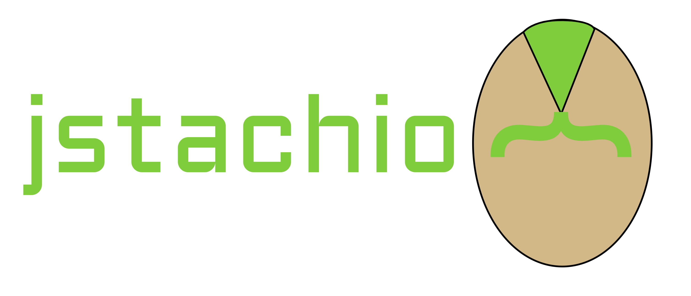
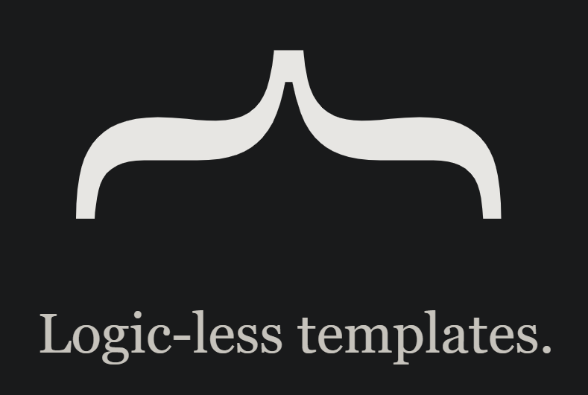



Notes:
There are multiple template engines for spring to render html with dynamic content like Apache Freemarker, JMustache or jstachio but in this talk we will take a look at Thymeleaf and JTE, the Java Template Engine. But before I begin, the choice of template engine is not really that important.
In the end we just render properties to strings and use if, else and loops to generate your HTML.

Slide 31
Notes:
First, let’s take a look at Thymeleaf.

Slide 32
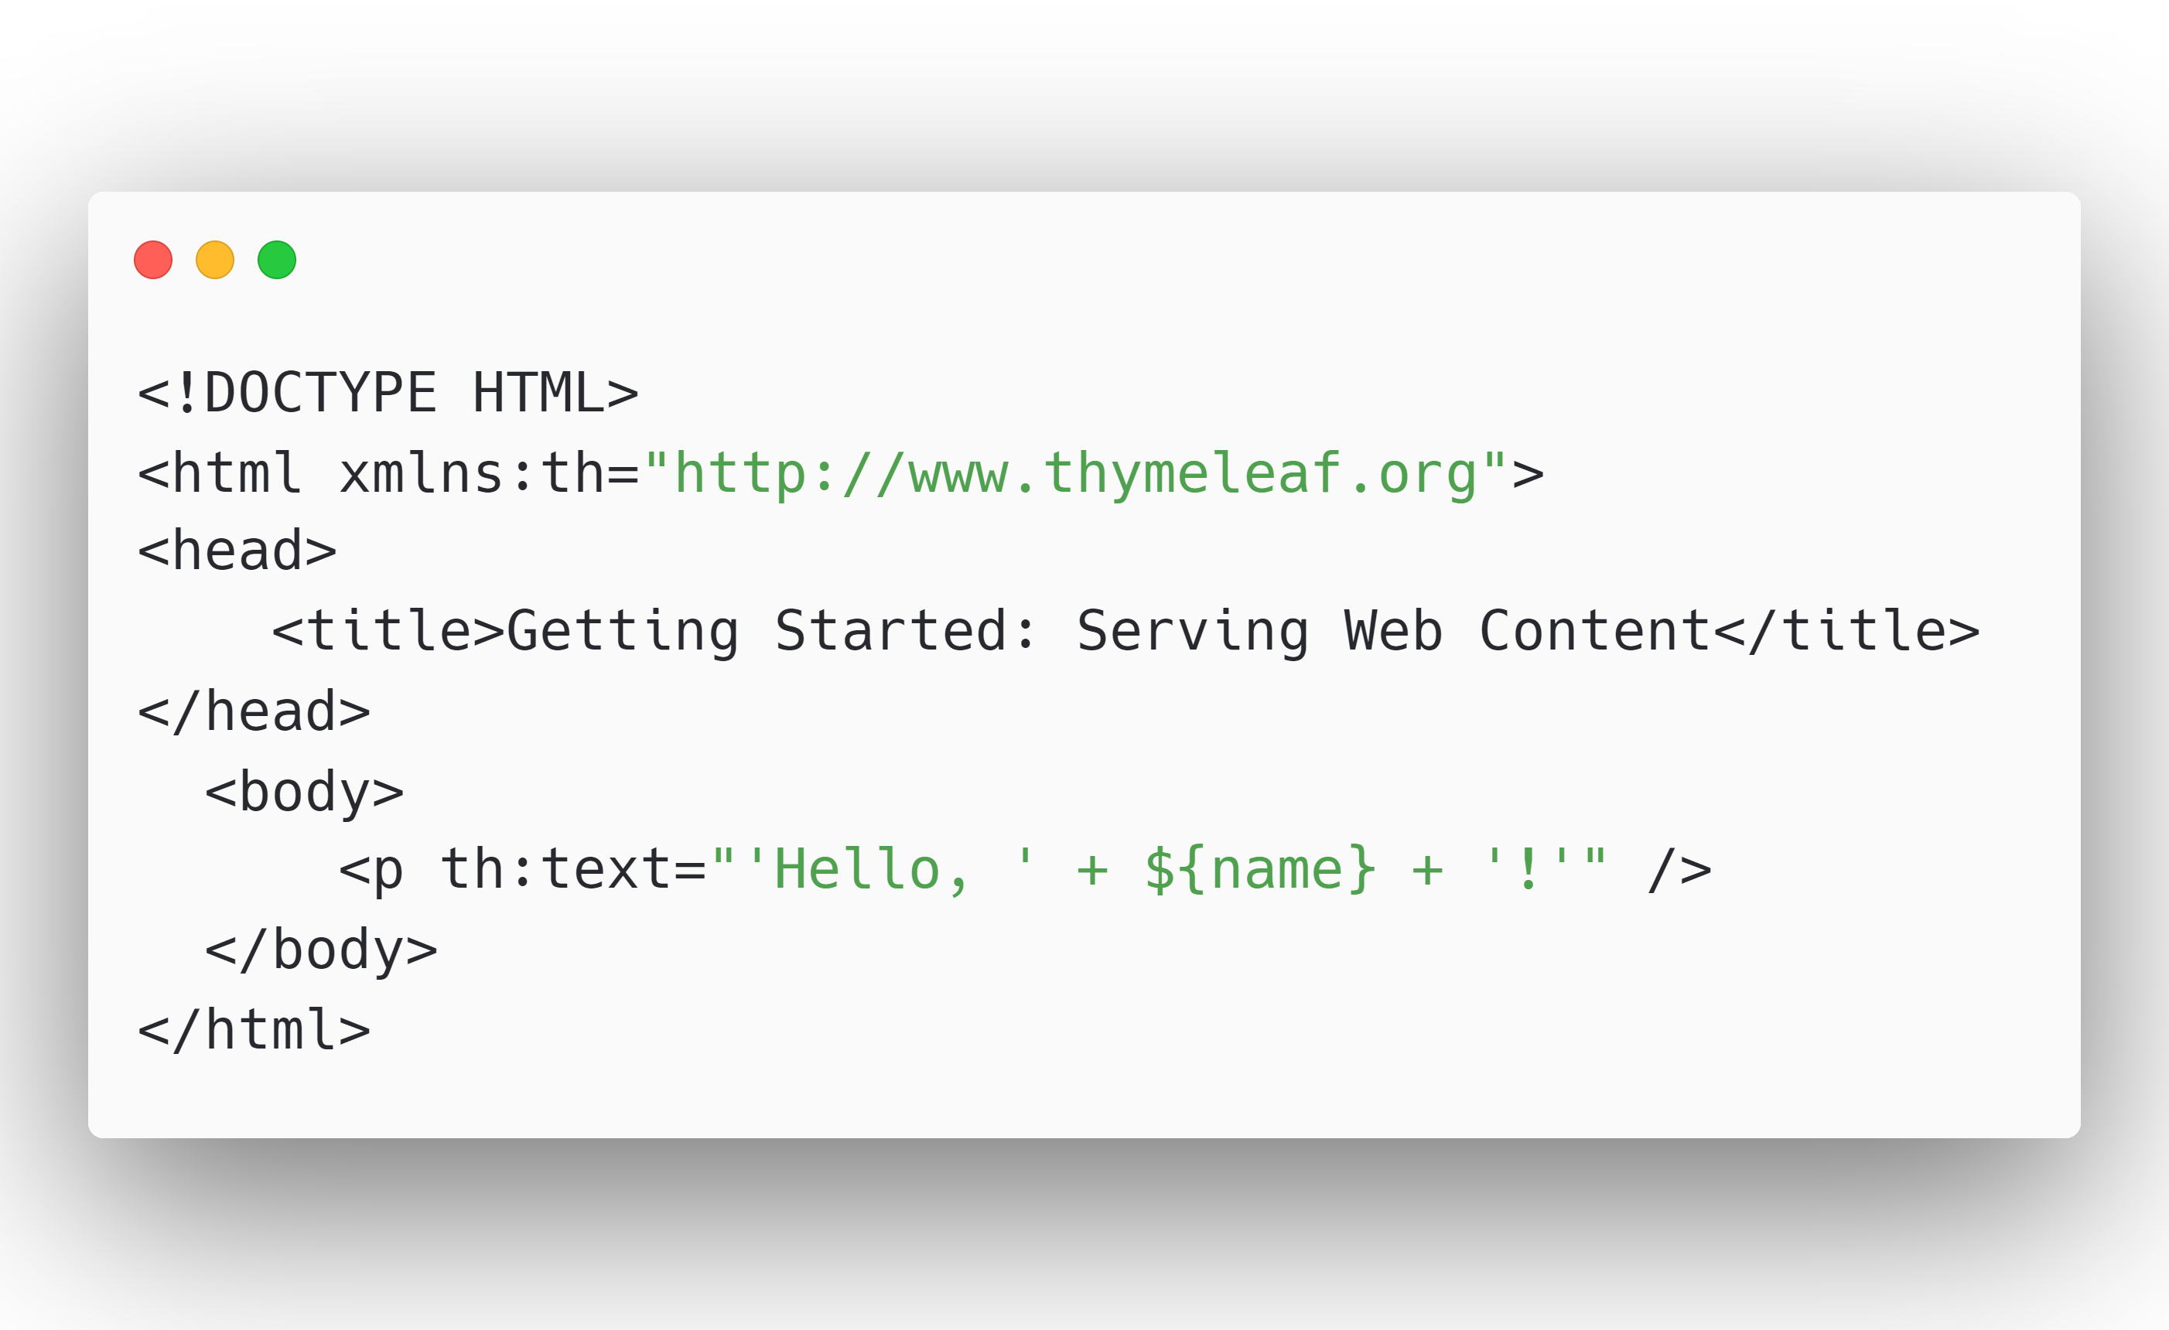
greeting.html
Notes:
It is simple to return rendered HTML from our Endpoints.
We’ll start with the greeting.html Template we just returned from our Controller. It is bog standard HTML,

Slide 33
greeting.html
Notes:
we just add a xml namespace tag at the top so our IDE picks up the thymeleaf template language. But this isn’t mandatory, it also works without the tag.

Slide 34
greeting.html
Notes:
To render the data we can define th colon attributes. In this case we define a th:text attribute.
This adds “hello” and the value of the model attribute “name” to the innerHTML of our p tag.

Slide 35
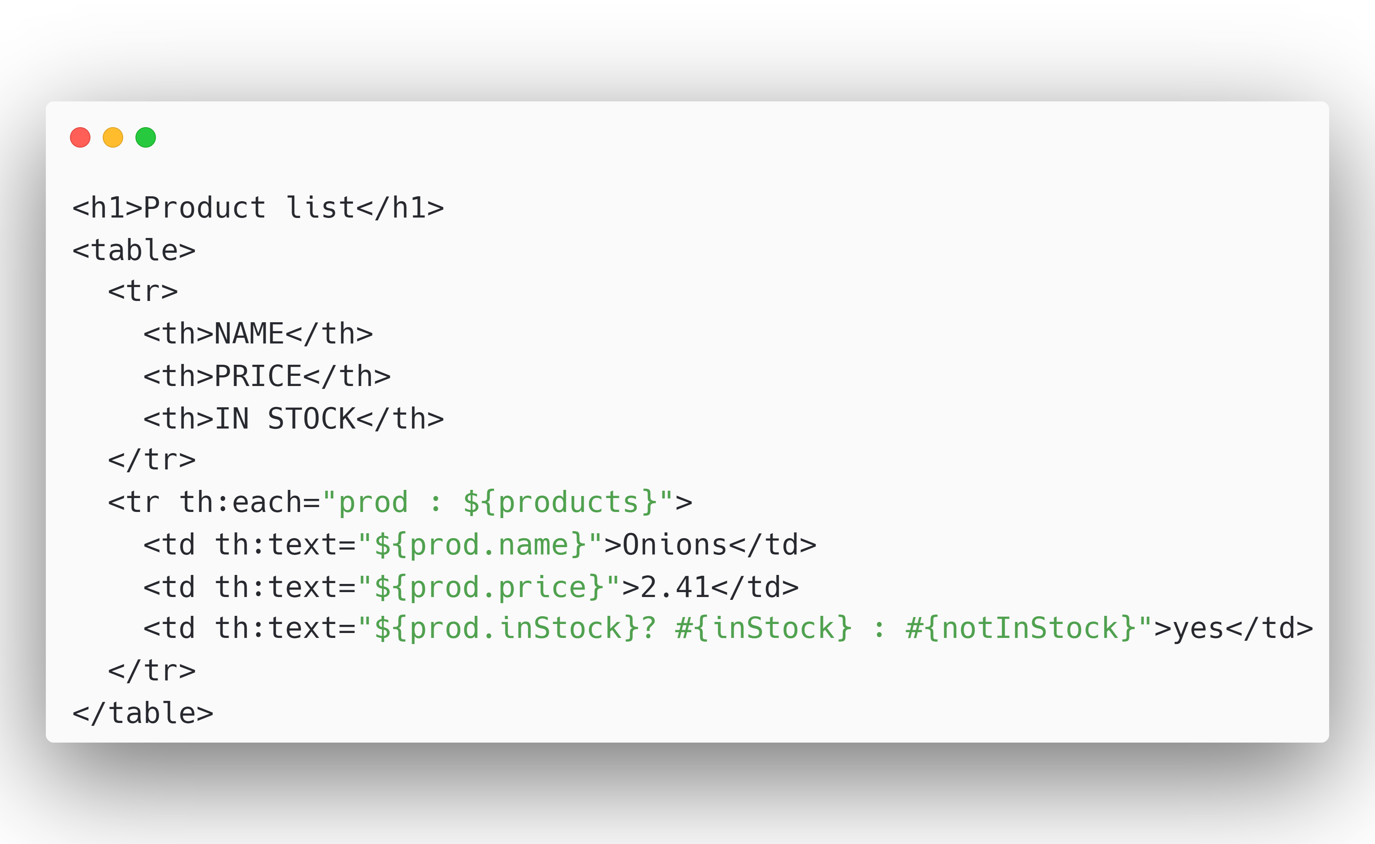
products.html
Notes:
We can also iterate over collections with the th:each tag. We can then access the properties of each object in our collection. In this example we show a table data cell for each property of our product object.

Slide 36
products.html
Notes:
Conditionals are also very simple. We use the ternary operator you might now from other languages.
If the inStock boolean evaluates to true we will show the message inStock and else we show the message notInStock
Thymeleaf has a lot more features, but I will not go more in depth, as you can build so much with these two already.

Slide 37
Notes:
Next, we will look at the Java Template Engine, which might feel more natural for Java Developers and has an awesome IntelliJ Plugin that makes JTE very productive.

Slide 38
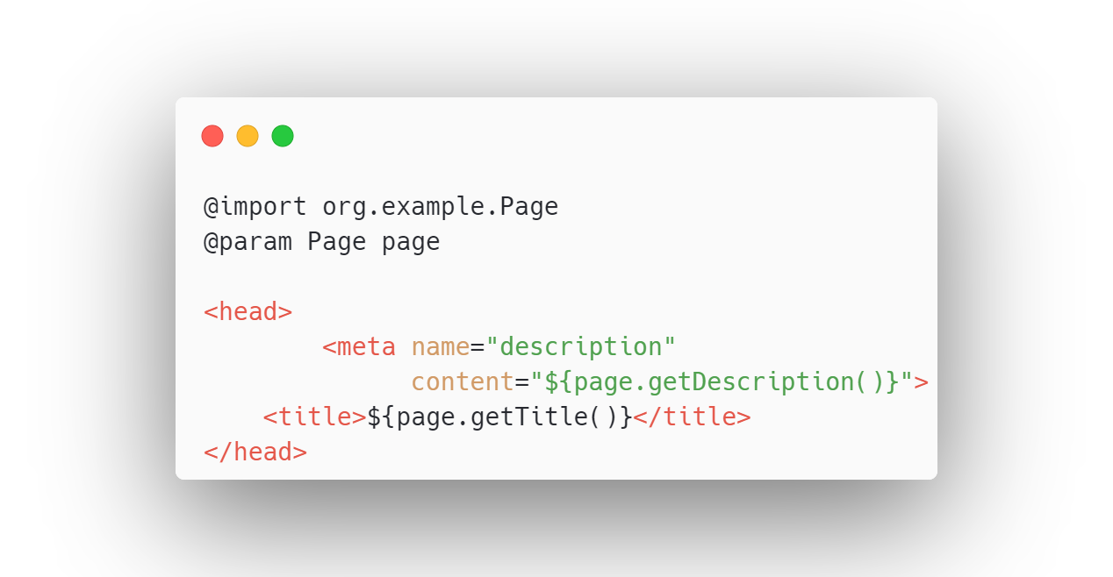
page.jte
Notes:
With JTE we can use plain java expressions right inside the html, inside some curly braces. You can use them wherever you want, inside attributes or between html tags.

Slide 39
page.jte
Notes:
Because JTE Templates are compiled to native Java classes, you need to import necessary Classes with the @import syntax, you also declare the parameters that need to exist in the model right on the template with an @param annotation.

Slide 40
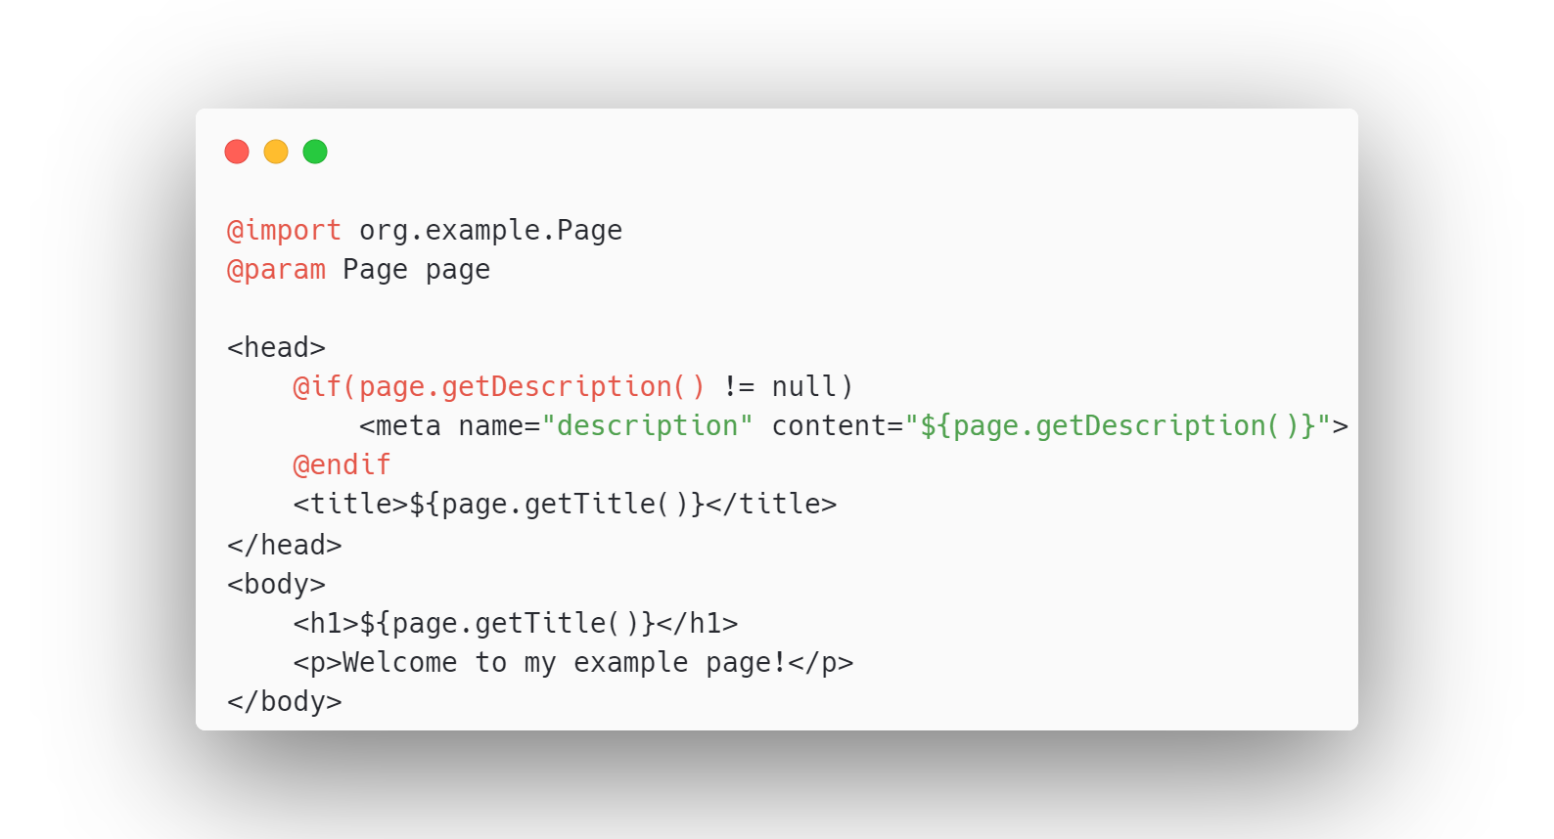
page.jte
Notes:
You can also use control structures like ifs that feel like java right in your HTML. Here we check that the description is not null.

Slide 41
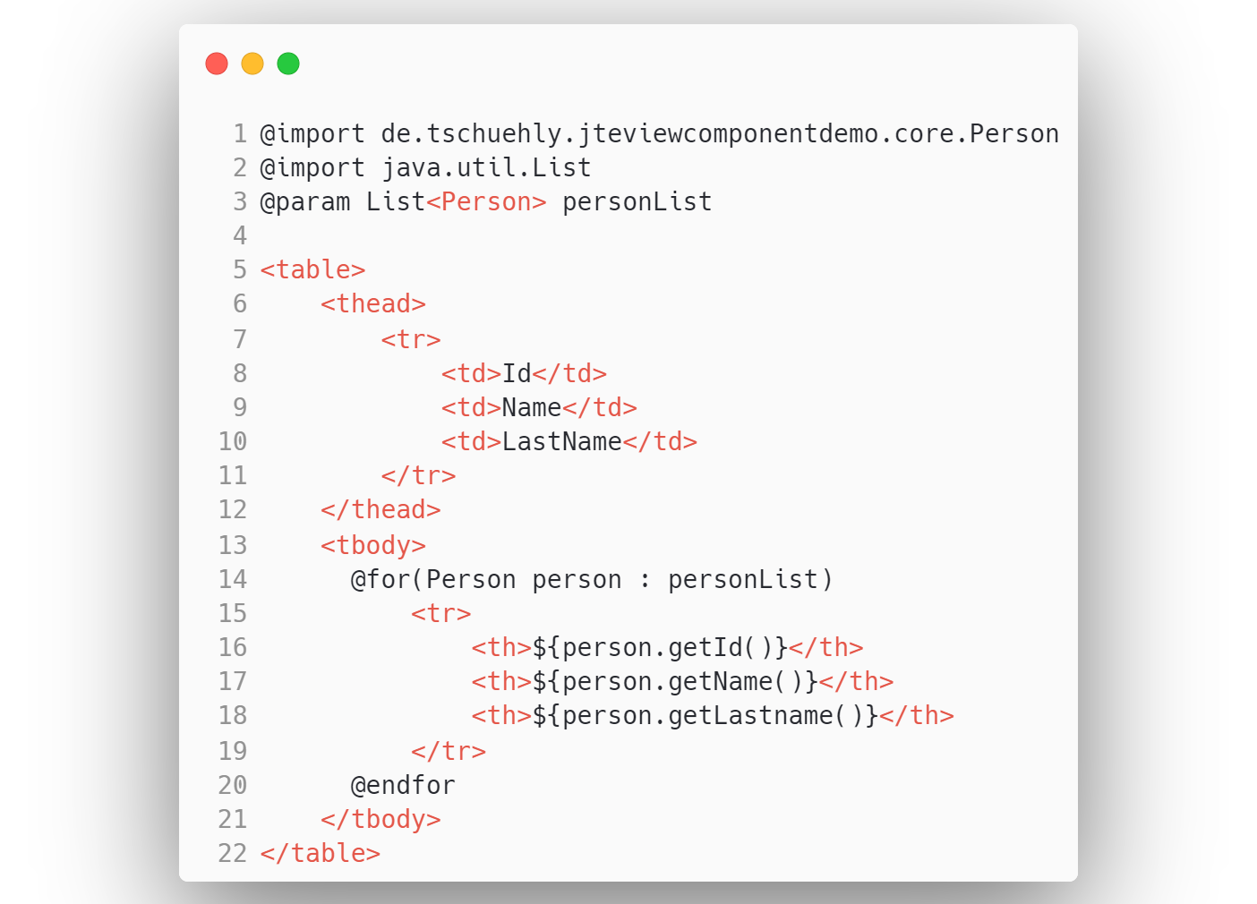
personlist.jte
Notes:
We can also you use for loops, for example to loop over a List of Objects to create a Table.
In this example we have a list of persons and we want to show each person as a row of our table.

Slide 42
Notes:
The Model View Controller Approach is quite simple but it has some shortcomings that bugged me over the last year while building my Software as a Service Side Business with Spring and Thymeleaf.
The two most popular JavaScript SPA Frameworks were build by some of the smartest Software Engineers in the world at Google and Facebook and there is a reason that they build UIs based on components. Because components make UI’s reusable and self-contained.

Slide 43


Notes:
And components are pretty cool, that’s why GitHub built their own ViewComponent library for their monolith server rendered ruby on rails web application, github.com.
But there weren’t components for creating reusable, typesafe UI’s with Spring Boot yet.

Slide 44

github.com/tschuehly/spring-view-component
Notes:
Well fret not, I’ve solved that with the Spring ViewComponent Library and I will show you how we solve the issues that occur with a MVC approach.

Slide 45
Template and Controller are tightly coupled
GreetingController.kt
greeting.html
Notes:
The first problem with MVC is that your controller needs to know what variables are used in your template, tightly coupling your controller to your View. And there are no compile time checks if the template has all model properties available.
This will get especially spicy if you reuse templates inside other templates. Because if you want to change the template variables you need to change the model in every controller method that returns this template.

Slide 46
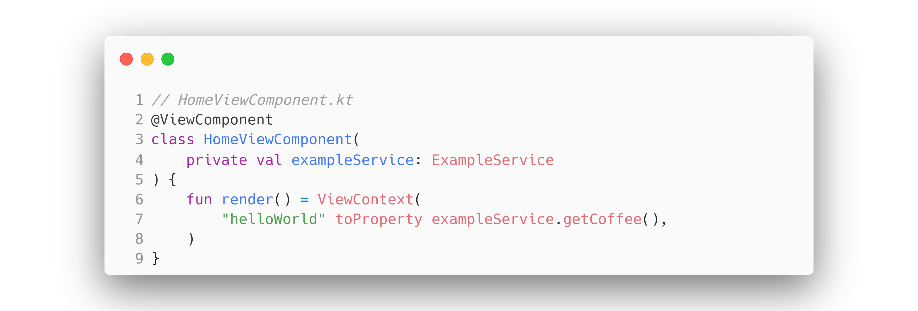
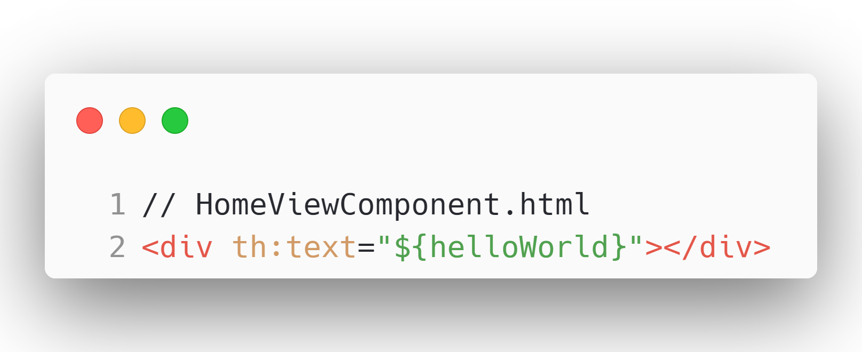
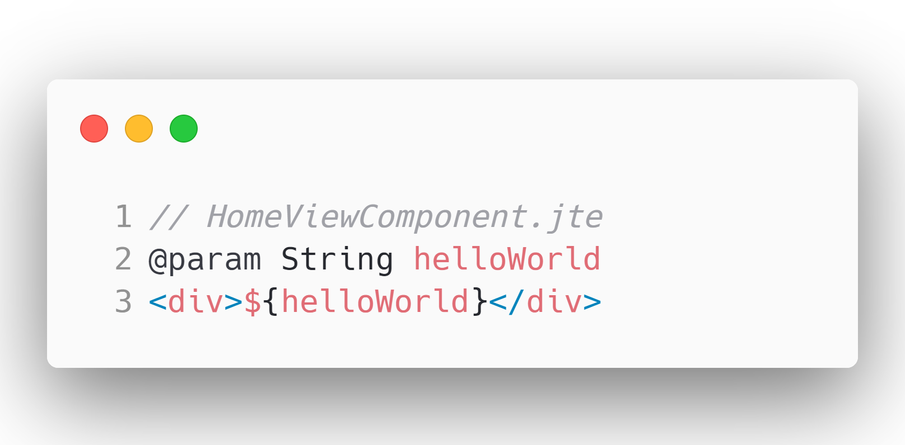
Notes:
We can solve this problem with Spring ViewComponents.
We create a component with the @ViewComponent Annotation, making it a Spring Managed Bean. Meaning we can use dependency injection like any other Spring Component.
Then the ViewComponent needs to define a render method that returns a ViewContext. It declares a helloWorld parameter that receives it’s info from an ExampleService.
A ViewComponent needs to have a template with the same name as the component in the same package.
In the template we can use all properties that we created in the ViewContext

Slide 47
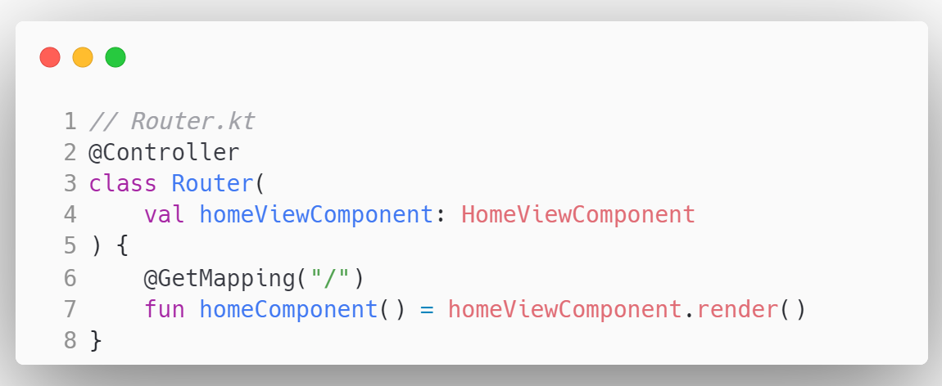
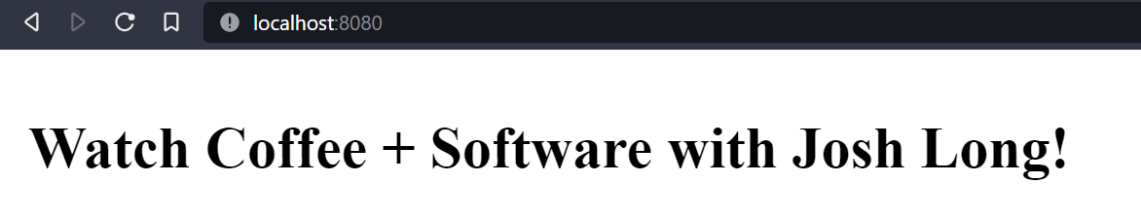
Notes:
Now if we want do display the component when a user navigates to a certain route we can just call the HomeViewComponent render method and return that in our Controller.
We now have clear separation of concerns, Controllers are responsible for routing, and not for data fetching. Instead our ViewComponent is responsible that the HTML Template has all data available for correct rendering.

Slide 48
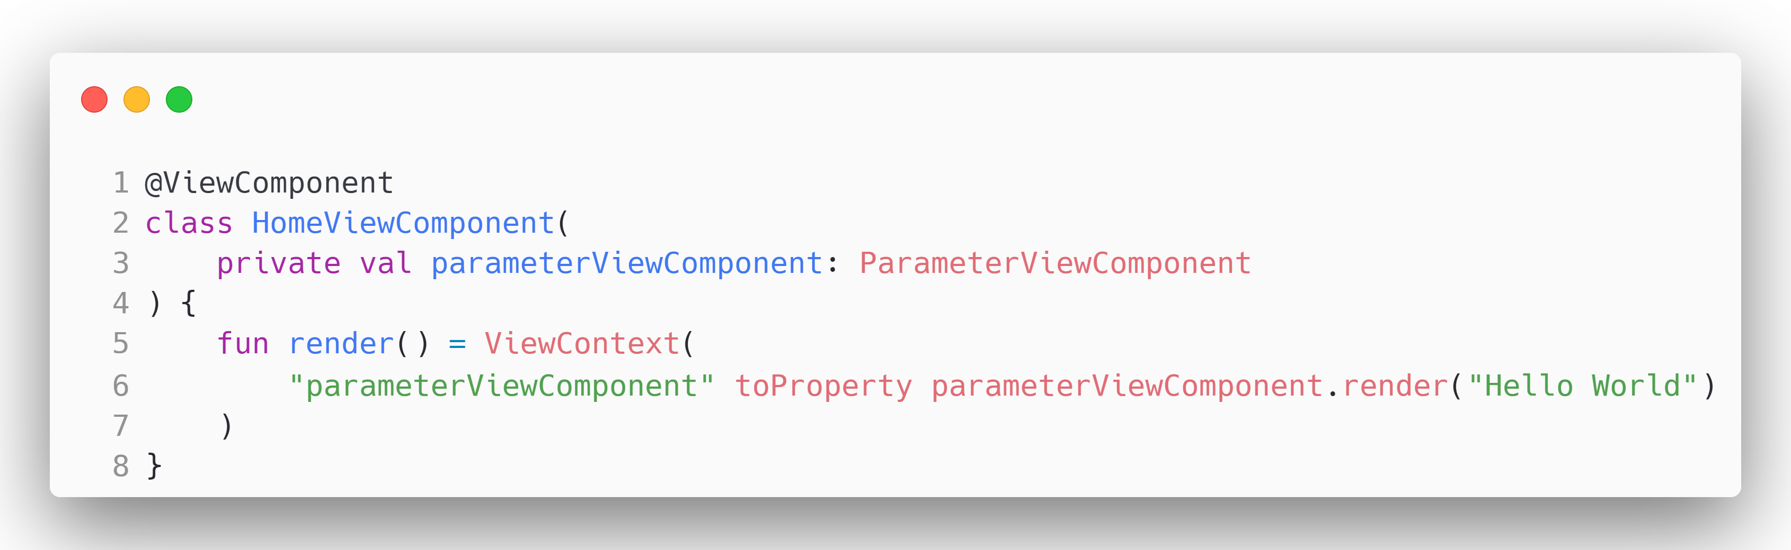
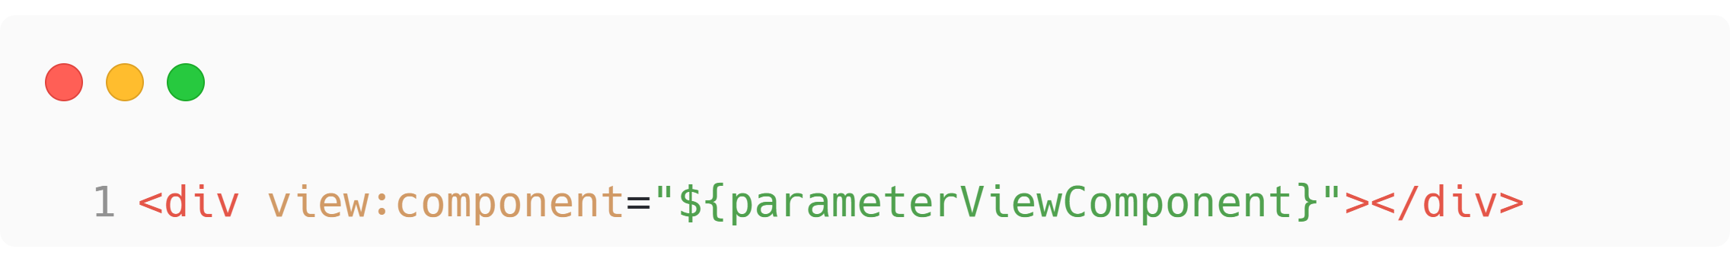
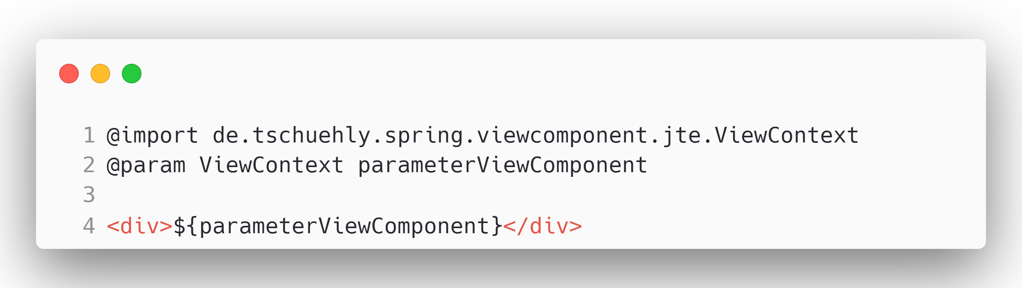
Notes:
We can nest components and thus reuse them efficiently with Spring ViewComponent.
We just need to pass the ViewContext that the parameterViewComponent.render method creates to our template.
With Thymeleaf, we use the view:component attribute and reference the parameterViewComponent ViewProperty.
With JTE we can use the parameterViewComponent ViewProperty inside a JTE Expression and JTE will insert the rendered HTML of the ParameterViewComponent at this location.
The HomeViewComponent is independent as it fetches the data for rendering itself but making it less reusable, as the data source is fixed.

Slide 49
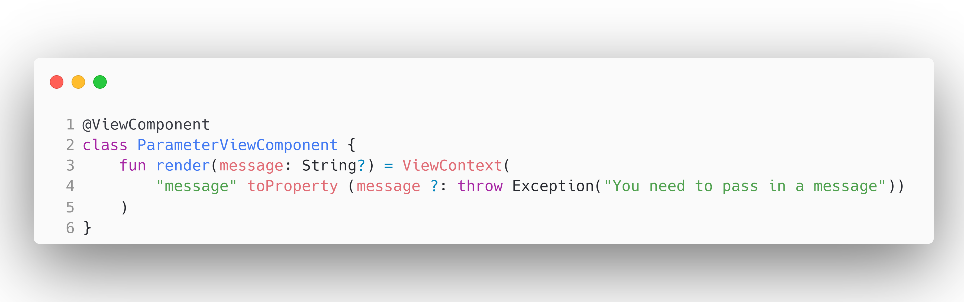
Notes:
To create reusable ViewComponents we can parameterize them. They don’t do any data fetching, and instead rely on the parent component to pass the data via the render parameters, meaning we can easily reuse this component all over our application. This gives us the ability to easily create type safe templates for commonly used UI Patterns

Slide 50
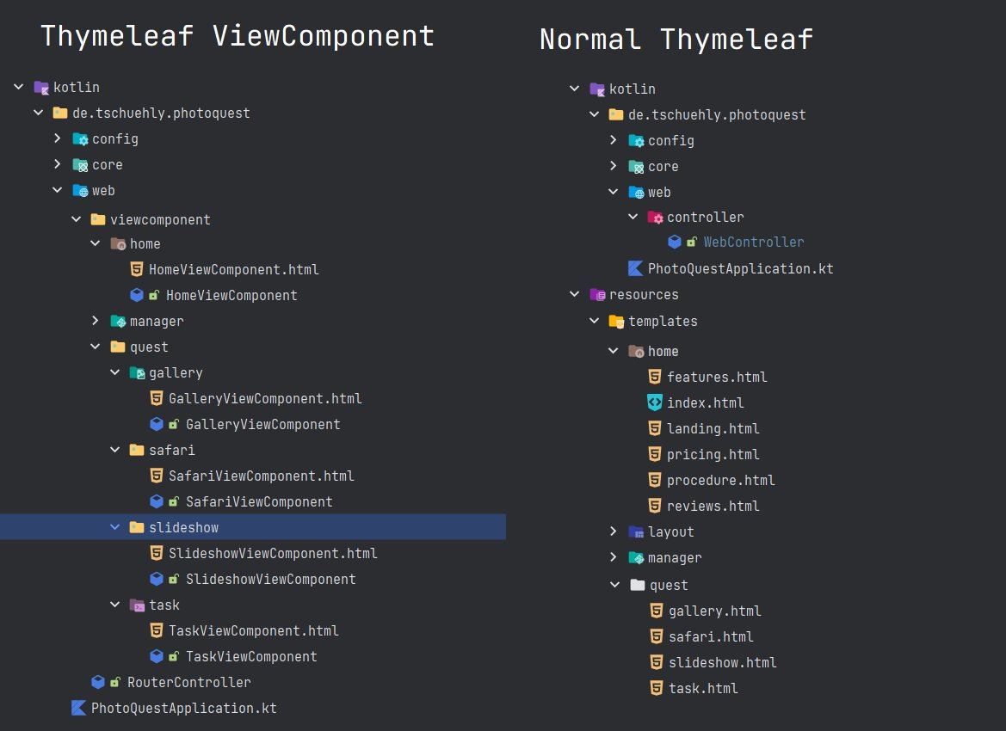
Notes:
With the MVC approach templates need to live in the resources folder, but your Controller is in your kotlin directory. Thus we have a strong disconnect between where the data for the templates is aggregated and where the templates use that data. This structure provides very low cohesion and adds cognitive load when trying to evolve our Frontend.

Slide 51
Notes:
With Spring ViewComponent we can create a highly cohesive code structure because each template needs to live in the same package as the data provider. What this also allows is a completely feature based package structure.
You can see here that with MVC our slideshow feature is split in two completely separated files while with ViewComponents our whole feature is nicely bundled into a package.

Slide 52
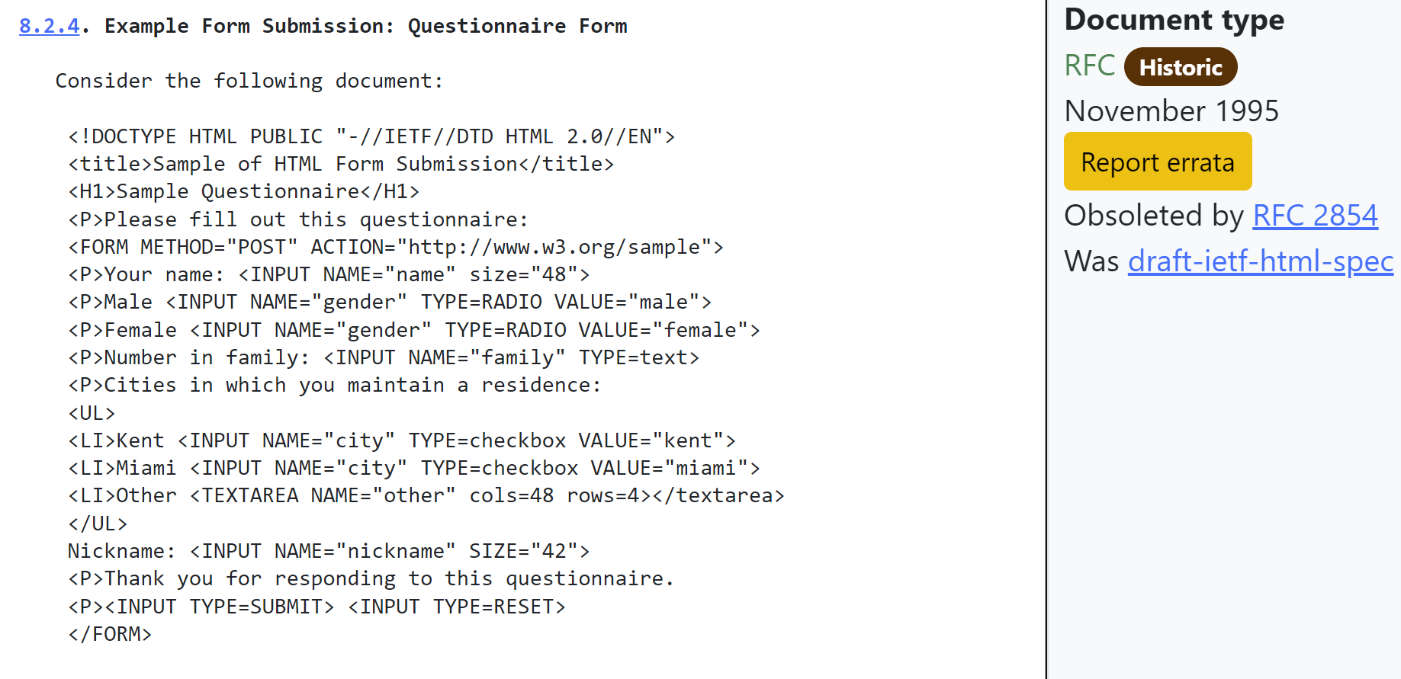
Notes:
But why did we move away from the Hypermedia model to the JavaScript Dystopia of today, if it is so simple to create HTML on the Server? We did because HTML is quite limited and did not really evolve as a Hypermedia. If you think about it, there are only two hypermedia controls, the anchor tag enabled the fundamental hypermedia system we know as the world wide web, by allowing to interconnect resources with URIs.
The second element was the form tag, introduced in the HTML 2 RFC in 1995. It enabled transactions for this vast hypermedia system for the first time and it made web experiences as we know them today possible. But as you can see a form looks the same as it did 28 years ago.

Slide 53
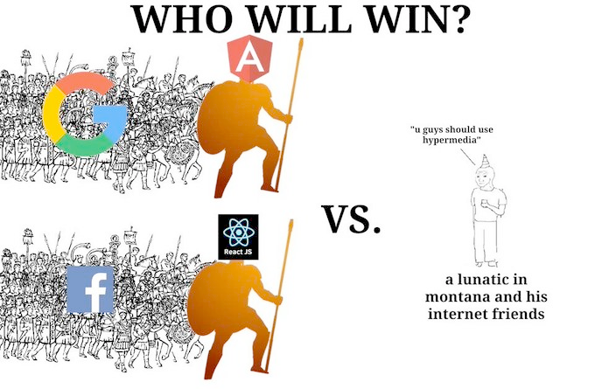
Notes:
But one guy in Montana and his friends were not satisfied with that and started a Library to complete HTML as a Hypermedia and compete against the giant JavaScript Ecosystem fuelled by big tech as we know it today.

Slide 54

Notes:
This Library is called htmx and is gaining traction over the last year. Recently getting picked up by GitHubs first open source accelerator program.
In a Nutshell htmx allows you to access modern browser features without ever leaving your HTML, you can create interactive features without needing to touch any JavaScript.

Slide 55
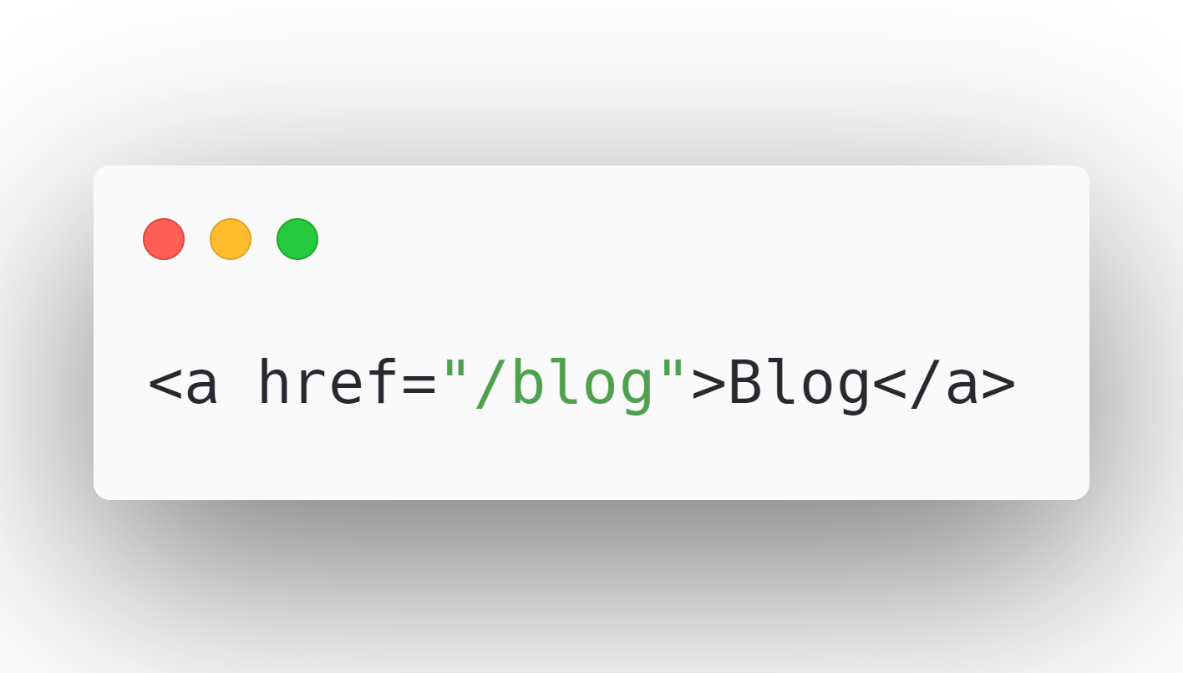
Notes:
To understand htmx we will first take a look at the native anchor tag:
This anchor tag tells a browser:
“When a user clicks on this link, issue an HTTP GET request to ‘/blog’ and load the response content into the browser window”.

Slide 56
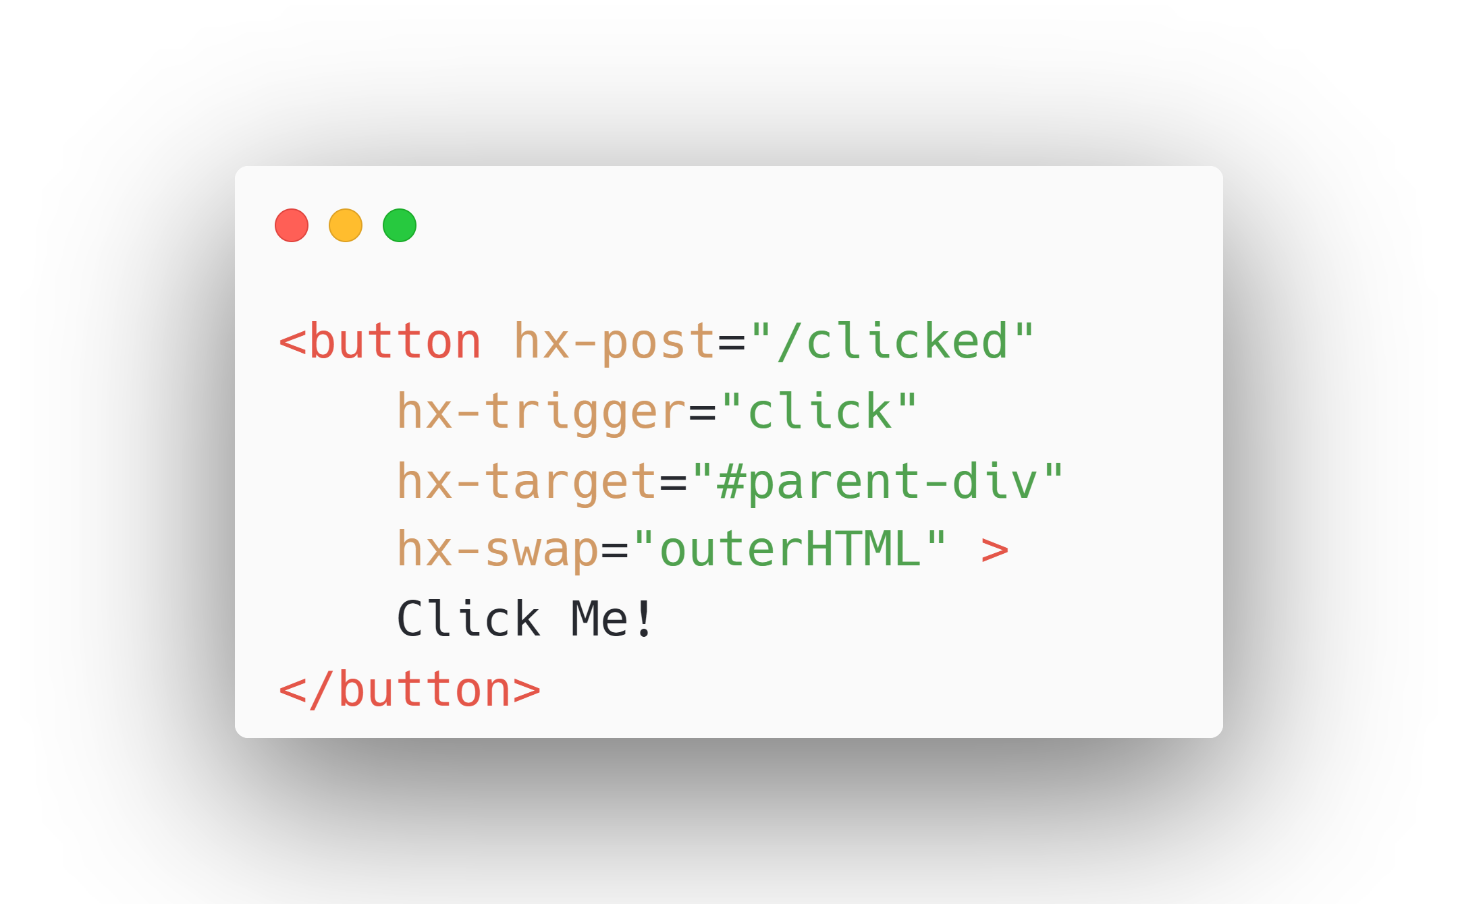
Notes:
If we now look at a simple example of HTMX: This tells htmx:
“Issue an HTTP POST request to ‘/clicked’ When a user clicks on this button, and use the content from the response to replace the element with the id parent-div in the DOM, and swap the whole element.” HTMX has sensible defaults, you wouldn’t need the hx-trigger attribute because it is the standard behaviour for a button element.
htmx extends and generalizes the core idea of HTML as a hypertext, opening up many more possibilities directly within the language.

Slide 57
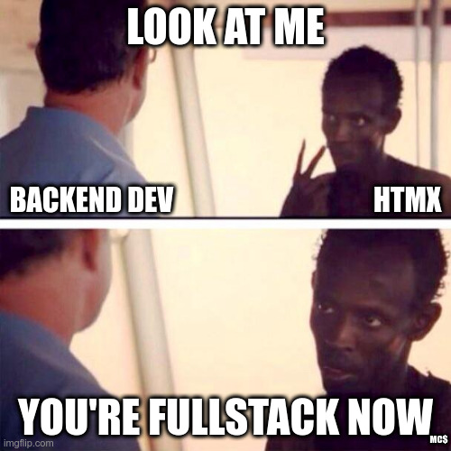
Notes:
We enable developers to easily create fullstack applications.
Now any element, not just anchors and forms, can issue an HTTP request
Now any event, not just clicks or form submissions, can trigger requests
Now any HTTP verb, not just GET and POST, can be used
Now any element, not just the entire window, can be the target for update by the request

Slide 58
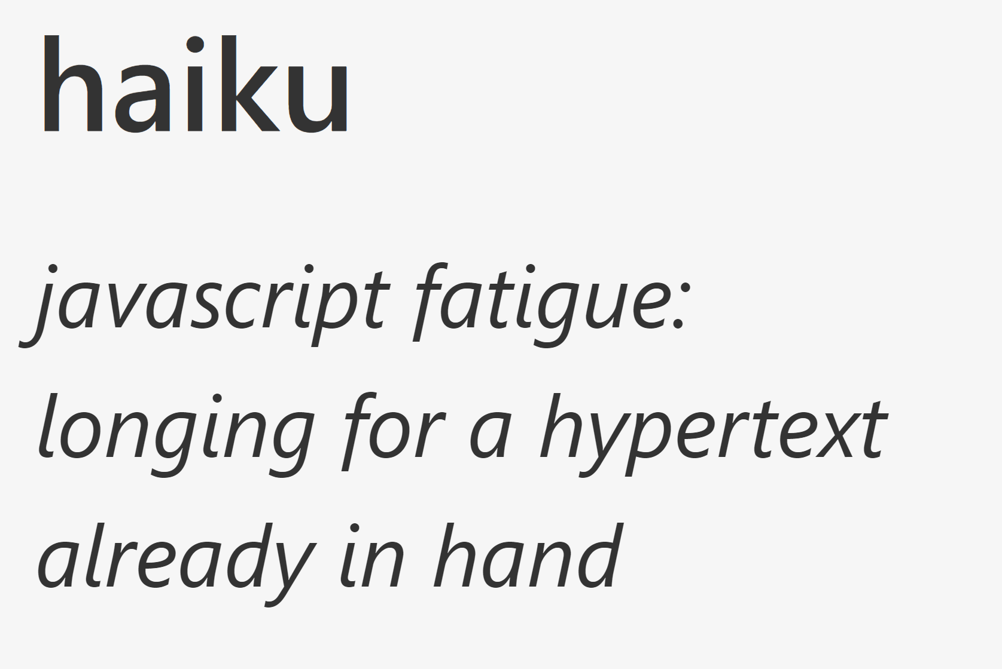
Notes:
HTMX refers to this style of application as a Hypermedia Driven Application or short HDA, as it tries to capture the advantages of both: the simplicity and flexibility of a MPA with a REST-ful architecture that uses Hypermedia As the Engine of Application State, with the better user experience of a Single Page Application.

Slide 59
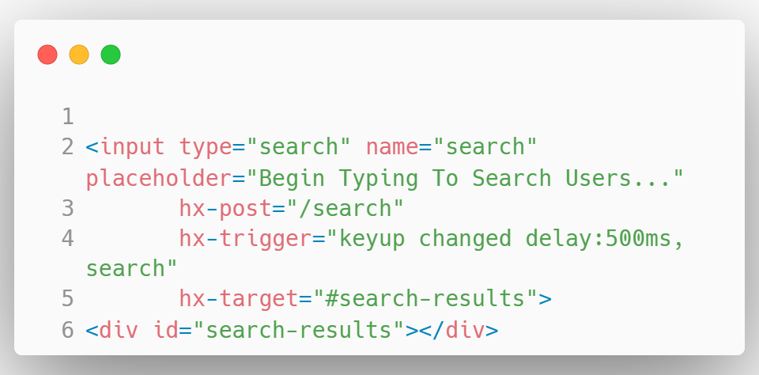
Notes:
This gives us the possibility to create UX Patterns that would typically be associated with an SPA, like Active Search.
This input field triggers a post request to the /search endpoint on every keyup, debounced by 500ms. Then the HTML Response is swapped with the search-results element.

Slide 60
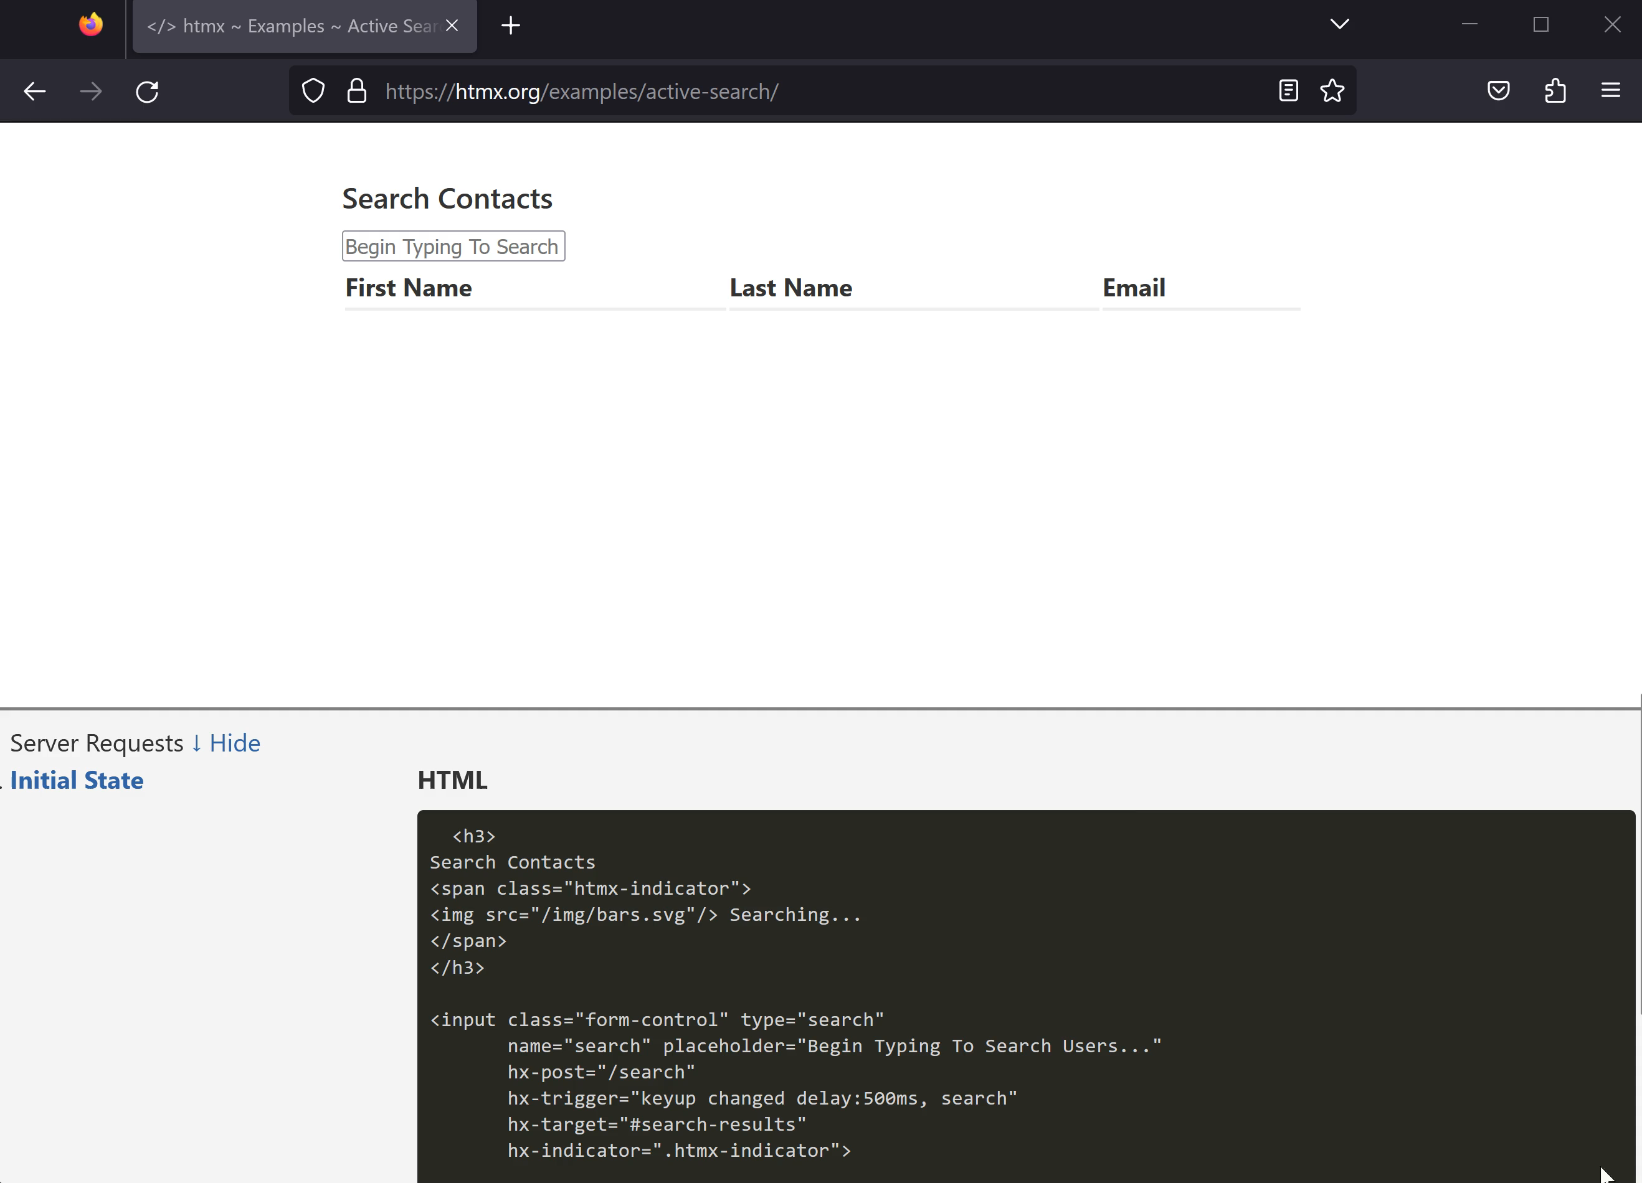
Notes:
Here you can see the active search example on htmx.org. It offers the same experience that you get with a Single Page Application but with way less complexity.
->
This example shows the essential characteristics of an HDA, the frontend of the feature is entirely specified in declarative htmx attributes inside the html and the interaction with the Server is done via HTTP and HTML, htmx makes the request for us and swaps the HTML into the DOM.
But it wouldn’t be a farfetched idea to think that If HTML would have evolved further as a Hypermedia that these features could be native HTML enabled by the browser.

Slide 61
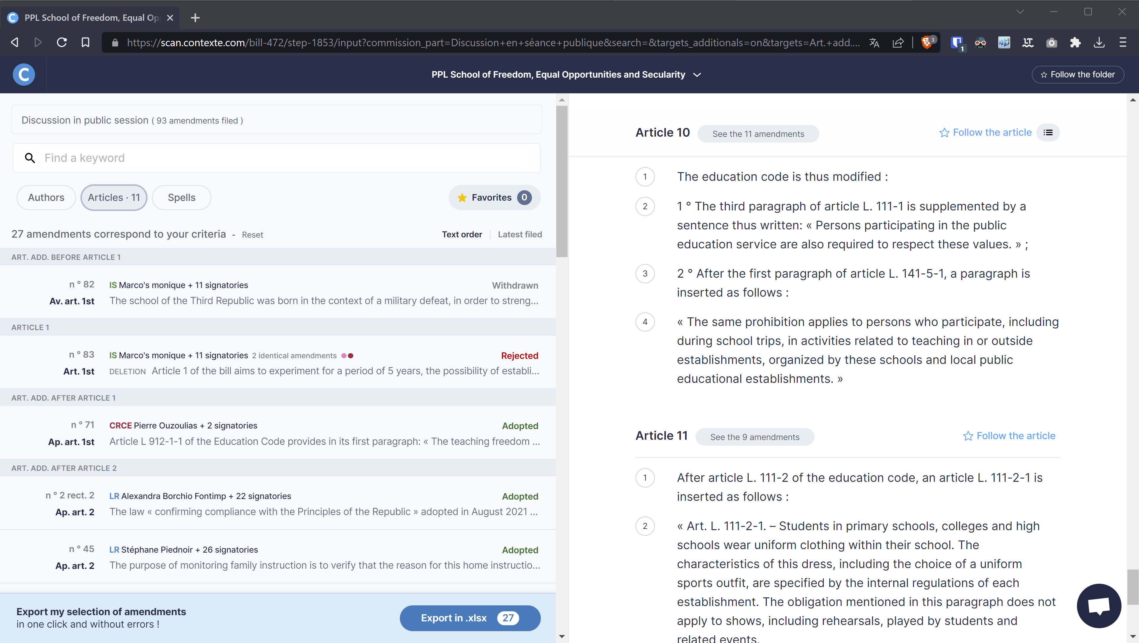
Notes:
Like every approach there are advantages and disadvantages that should be considered when choosing how we engineer our software.
Hypermedia Driven Applications are a good fit if your UI is mostly text and images, like a news article site that is oriented around media we want to display to our users.
Here is a real world example from the Software as a Service Startup Contexte which has transitioned their production application from Django plus React to Django plus HTMX.
They track legislation in the French senate and show amendments and make them searchable and filterable, all with the power of HTMX.

Slide 62
Notes:
If your UI is nested and the blocks needing to update are well defined it is quite easy to enable dynamic interaction. This lends itself especially to ViewComponents as we can just rerender our components on demand.
What you also get out of the box with a Hypermedia Driven Application is perfect first page render performance and Search Engine Optimization as it is just standard HTML.
As I’ve alluded to earlier there are certain use cases where a JavaScript centric approach makes more sense. If we need a high degree of sub ms interactivity, Google Sheets is an example that comes to mind.

Slide 63
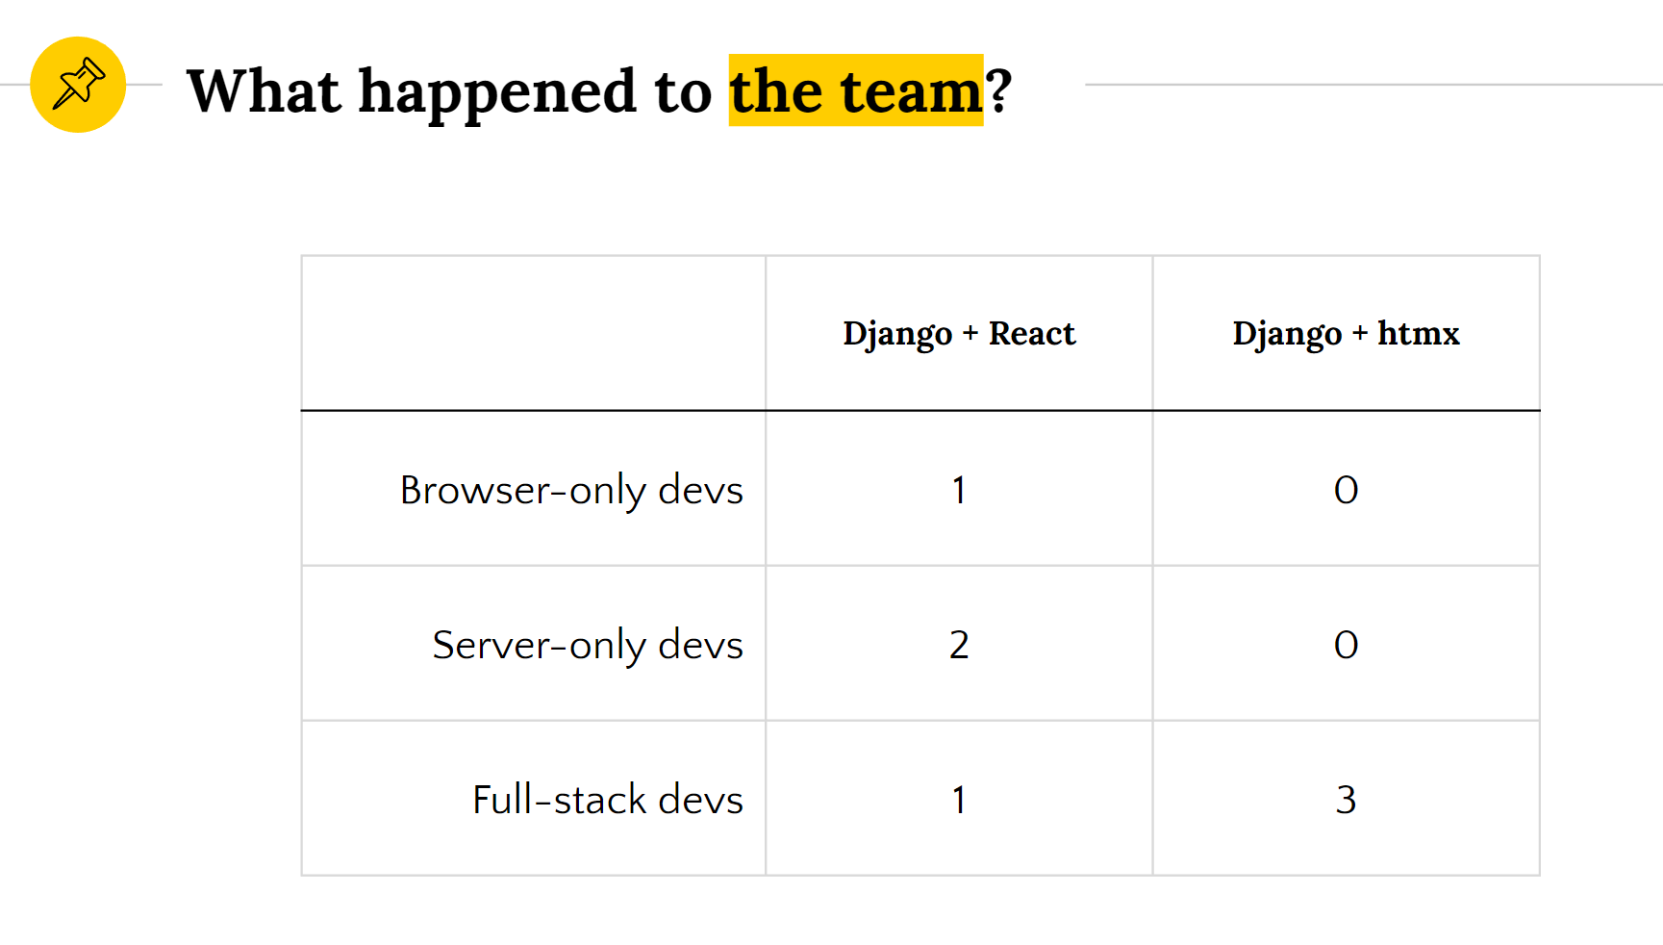
Software as a Service Startup „Contexte“
Notes:
Now I’ve talked why and how we can create Hypermedia Driven Applications, but one thing that should not be overlooked is how a team structure can change if you radically simplify your web development approach.
When Contexte was using react, there was a hard split between back-end and front-end, with two developers being entirely back-end, one developer being entirely front-end, and one developer being “full stack”.
After the port to HTMX, the entire team became “full stack” developers. Except the JavaScript Developer, he had to leave.
This means that each team member is more effective and able to contribute more value. It also makes development more fun, since developers can own an entire feature. Finally, it can lead to better optimized software, since the developer can make optimizations anywhere in the stack without needing to coordinate with other developers.

Slide 64
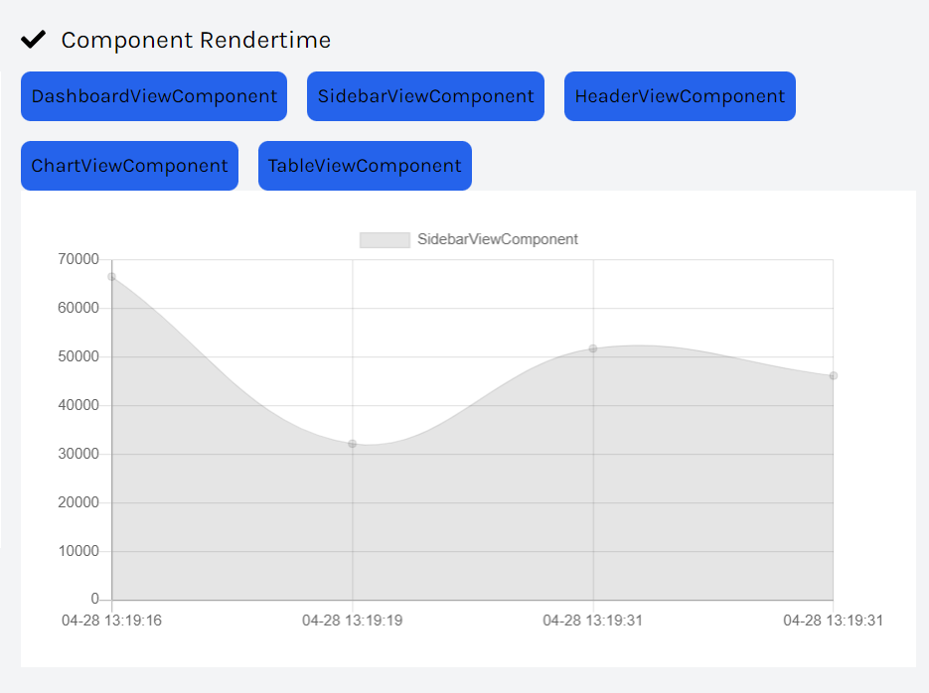
Notes:
Now we will look at how Spring ViewComponent can integrate with HTMX.
In this example we created an AnalyticsService that measures the rendertime of each ViewComponent using the Aspect Oriented Programming support of Spring.
We want to display a chart for each component to our User. Obviously we don’t want reloads of the whole page when we switch between components for a nice User Experience.

Slide 65
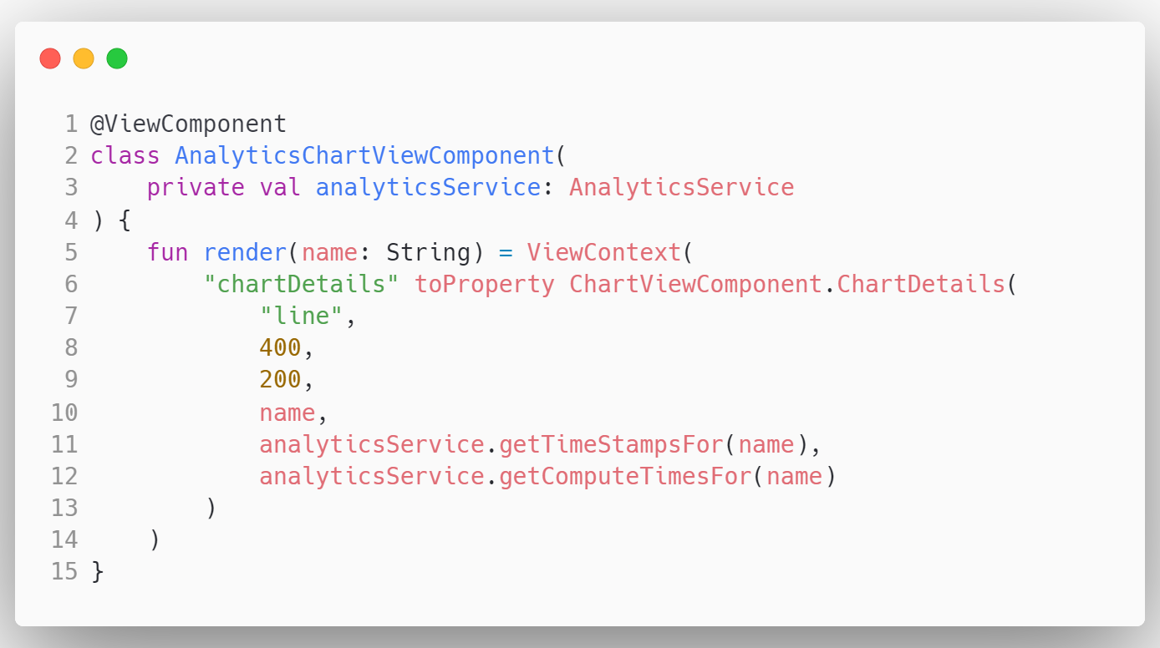
Notes:
First, we will create a AnalyticsChartViewComponent where we autowire the analyticsService and create a chart from a generic parameterized ChartViewComponent that wraps the chart.js library in a typesafe envelope. As you can see the ChartViewComponent self describes the API via a ChartDetails class. We can set what type of chart we want, the width and height, the name, and the Data and corresponding datapoint labels.

Slide 66
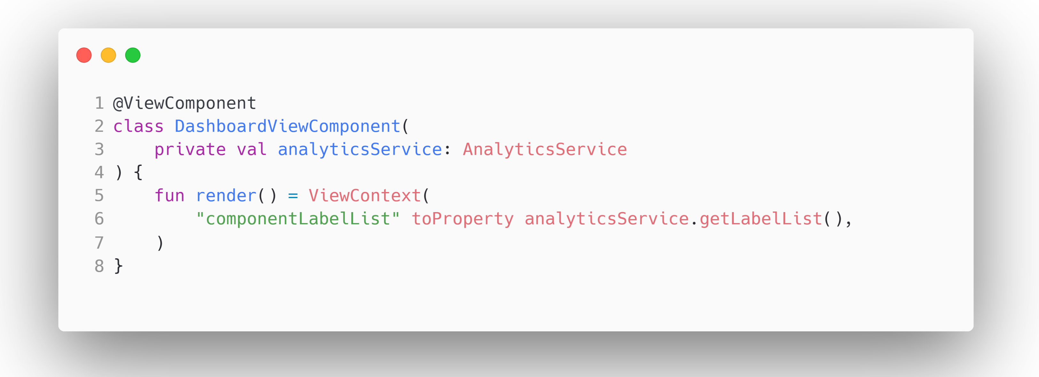
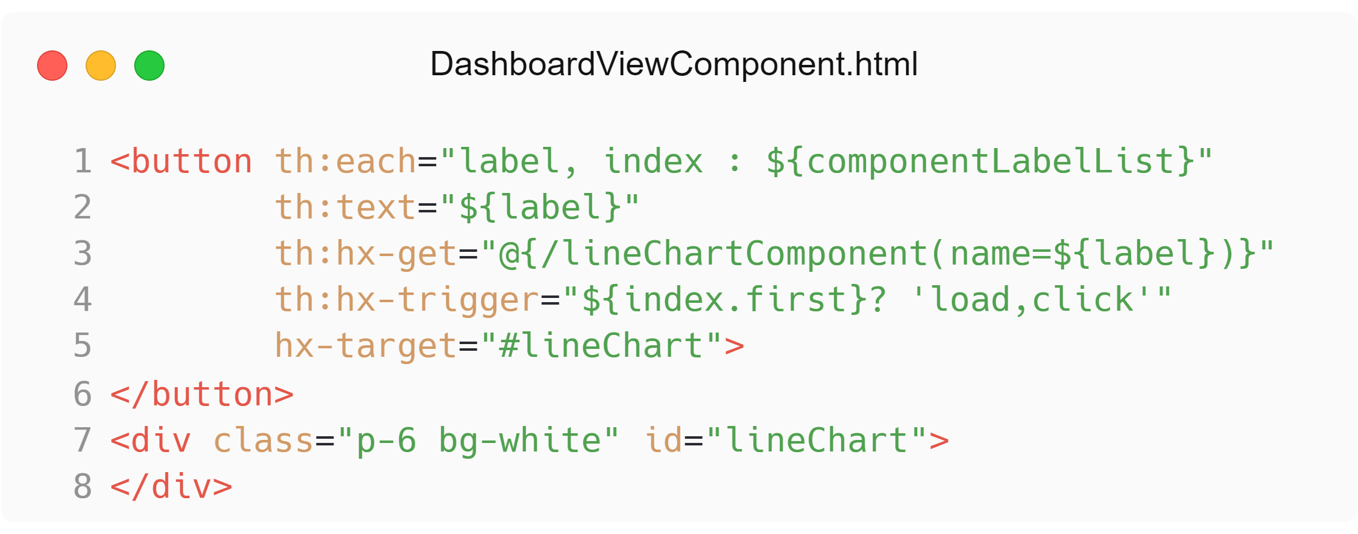
DashboardViewComponent.kt
Notes:
Then In our DashboardComponent., we will get all components we want to show in the selection from the analyticsService as componentLabelList, as we reference each component by it’s name
In the corresponding DashboardViewComponent.html we will loop over this List and show a button element for each using the Thymeleaf th:each attribute. Then we will set the button text with the th:text attribute to the label value. Now we will add the hx-get attribute and define the URL /linechartComponent with the attribute name=label.
That will create an HTML Get Request and swap the HTML. But to know with what element the response html should be swapped we define a hx-target attribute that will tell htmx to swap the response with the element with the id lineChart. Now we define a hx-trigger attribute for the first element that will automatically trigger the request for the first element on page load.

Slide 67
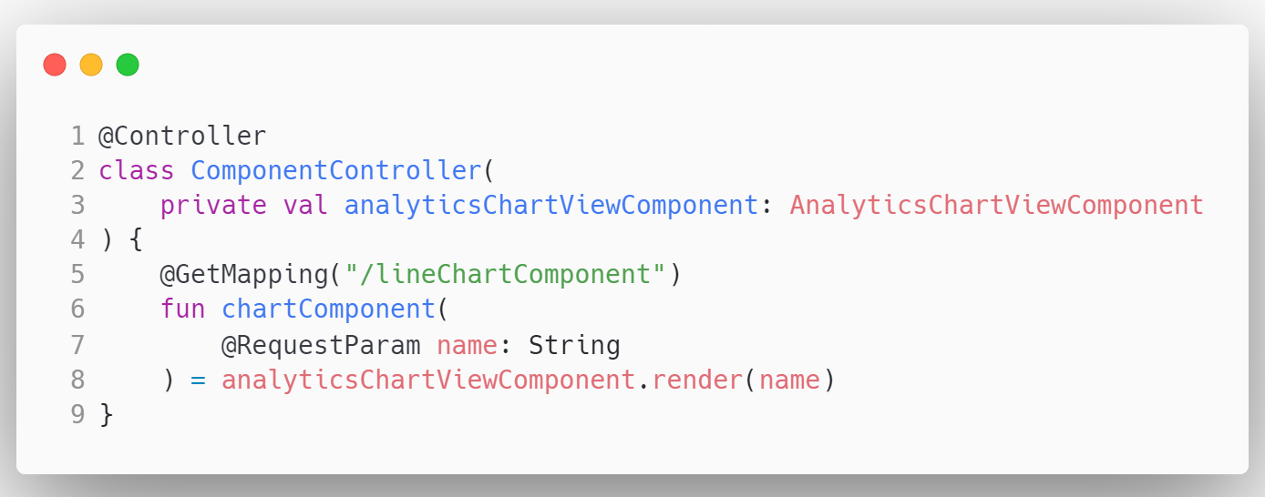
Notes:
The Last Step is to create a GetMapping with the name as requestparameter that renders the AnalyticsChartViewComponent.

Slide 68
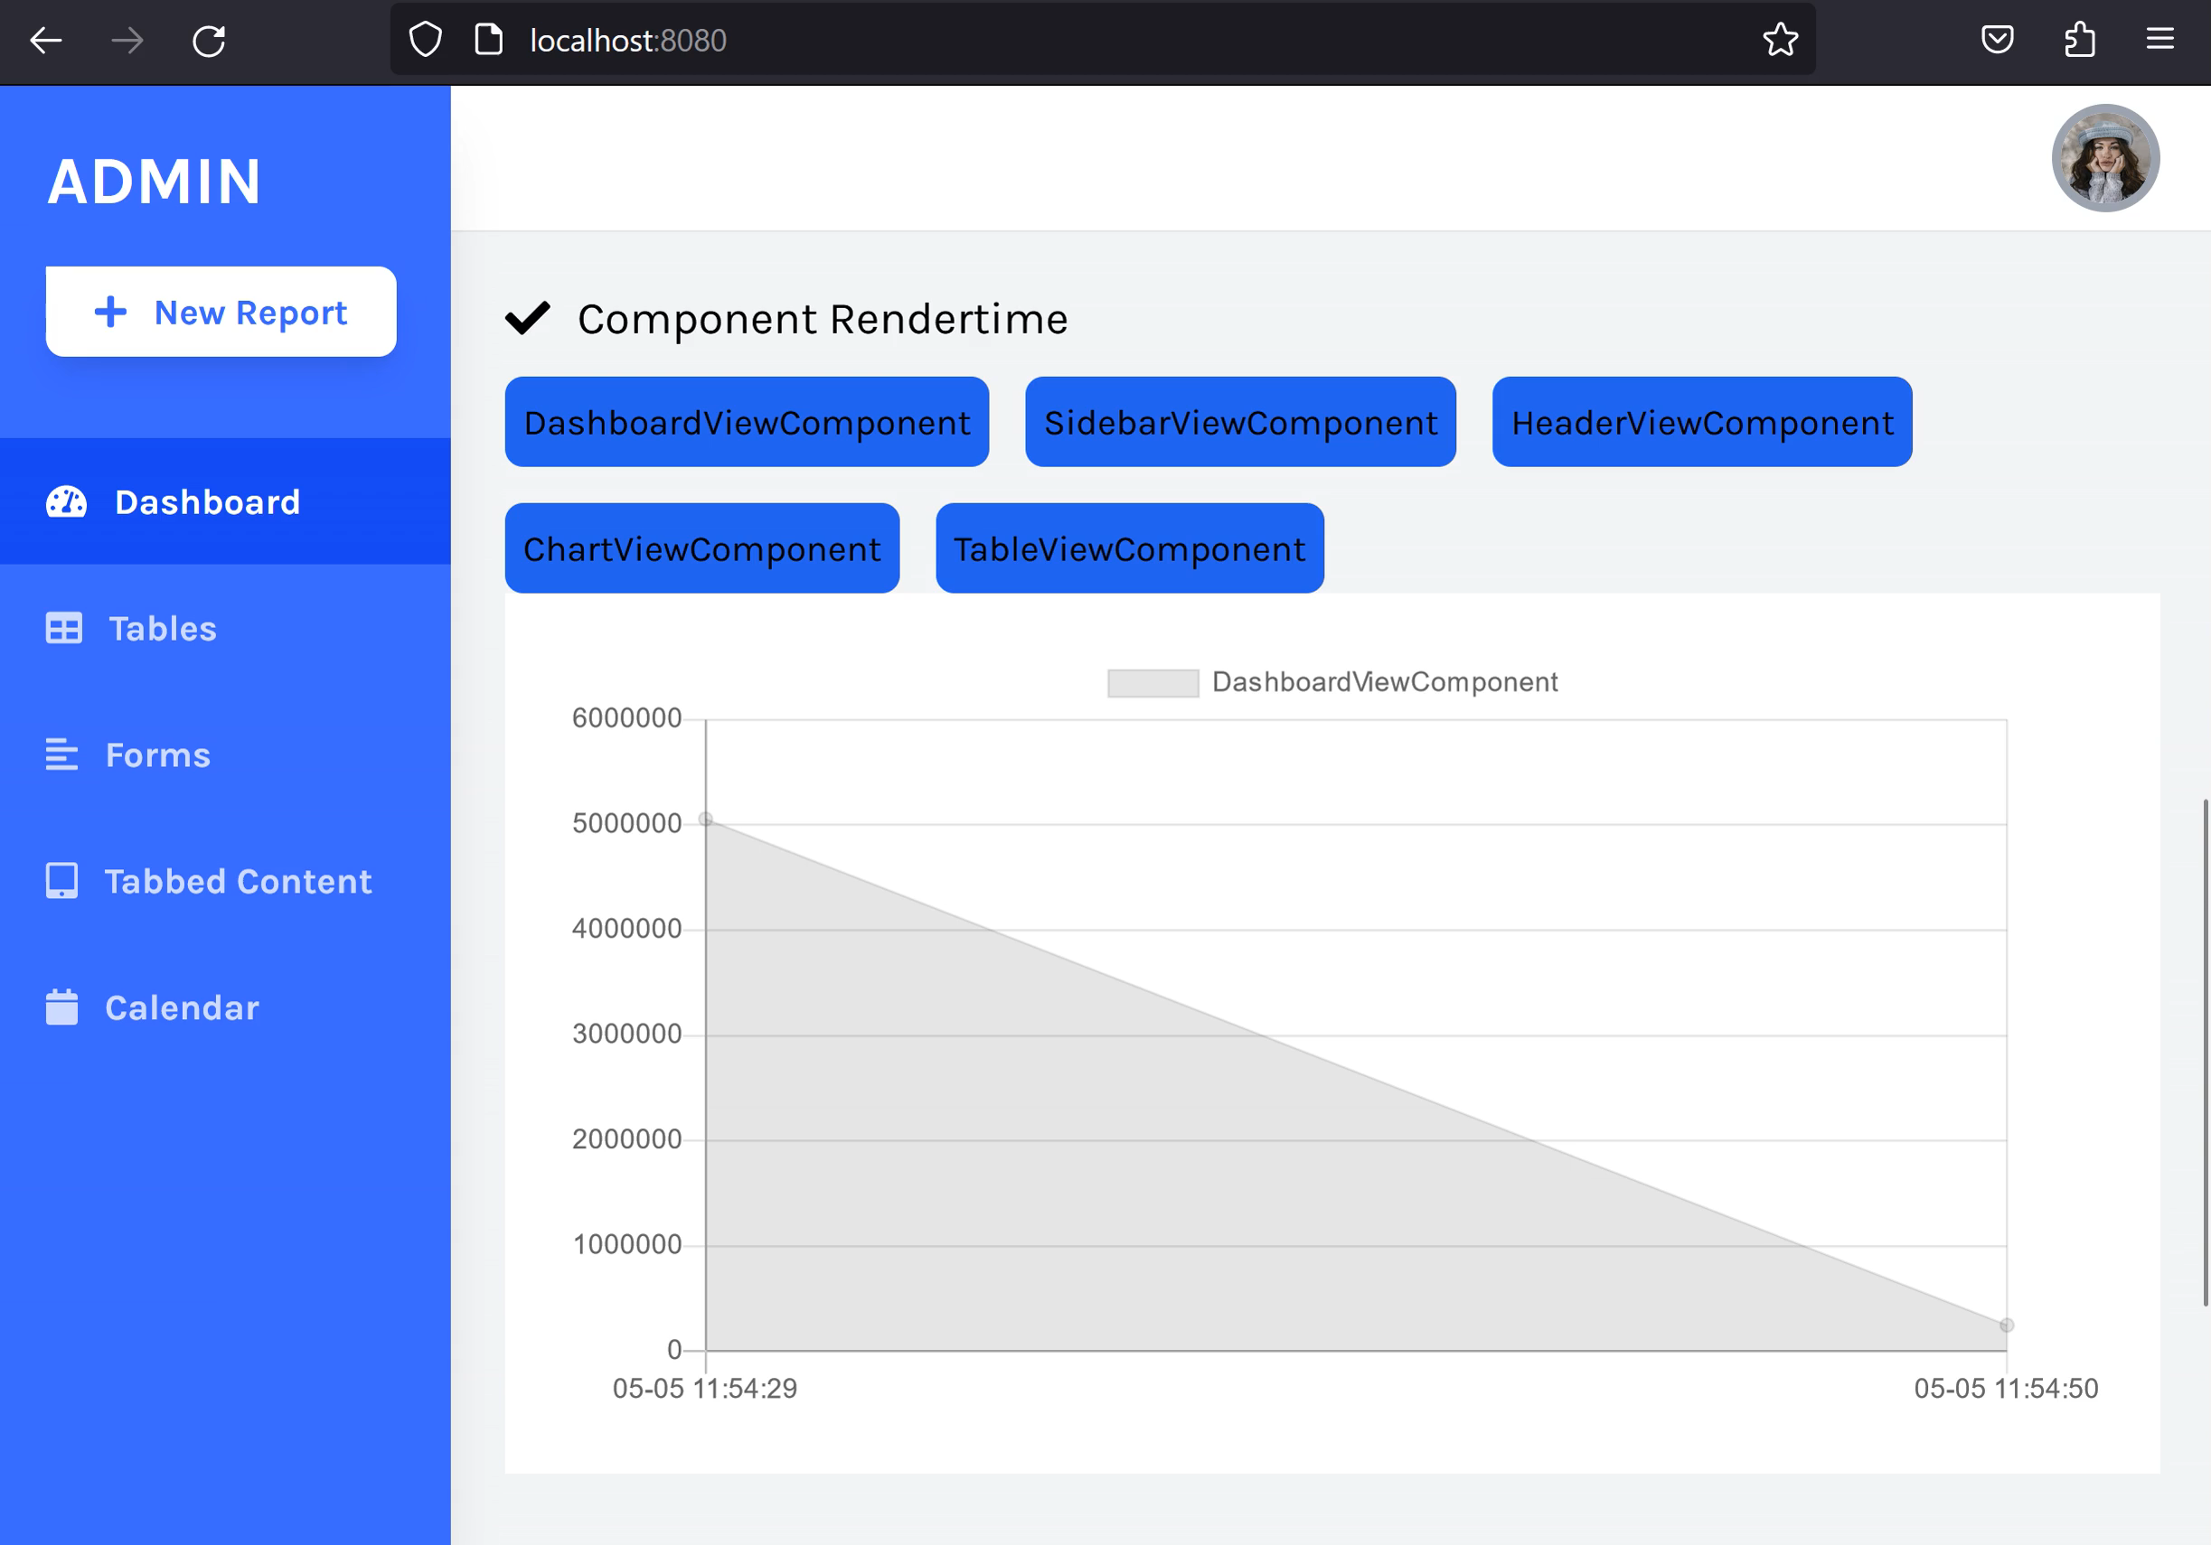
Notes:
Here is the example we just implemented. And as you can see that we have a fully interactive dashboard without any page refreshes.

Slide 69
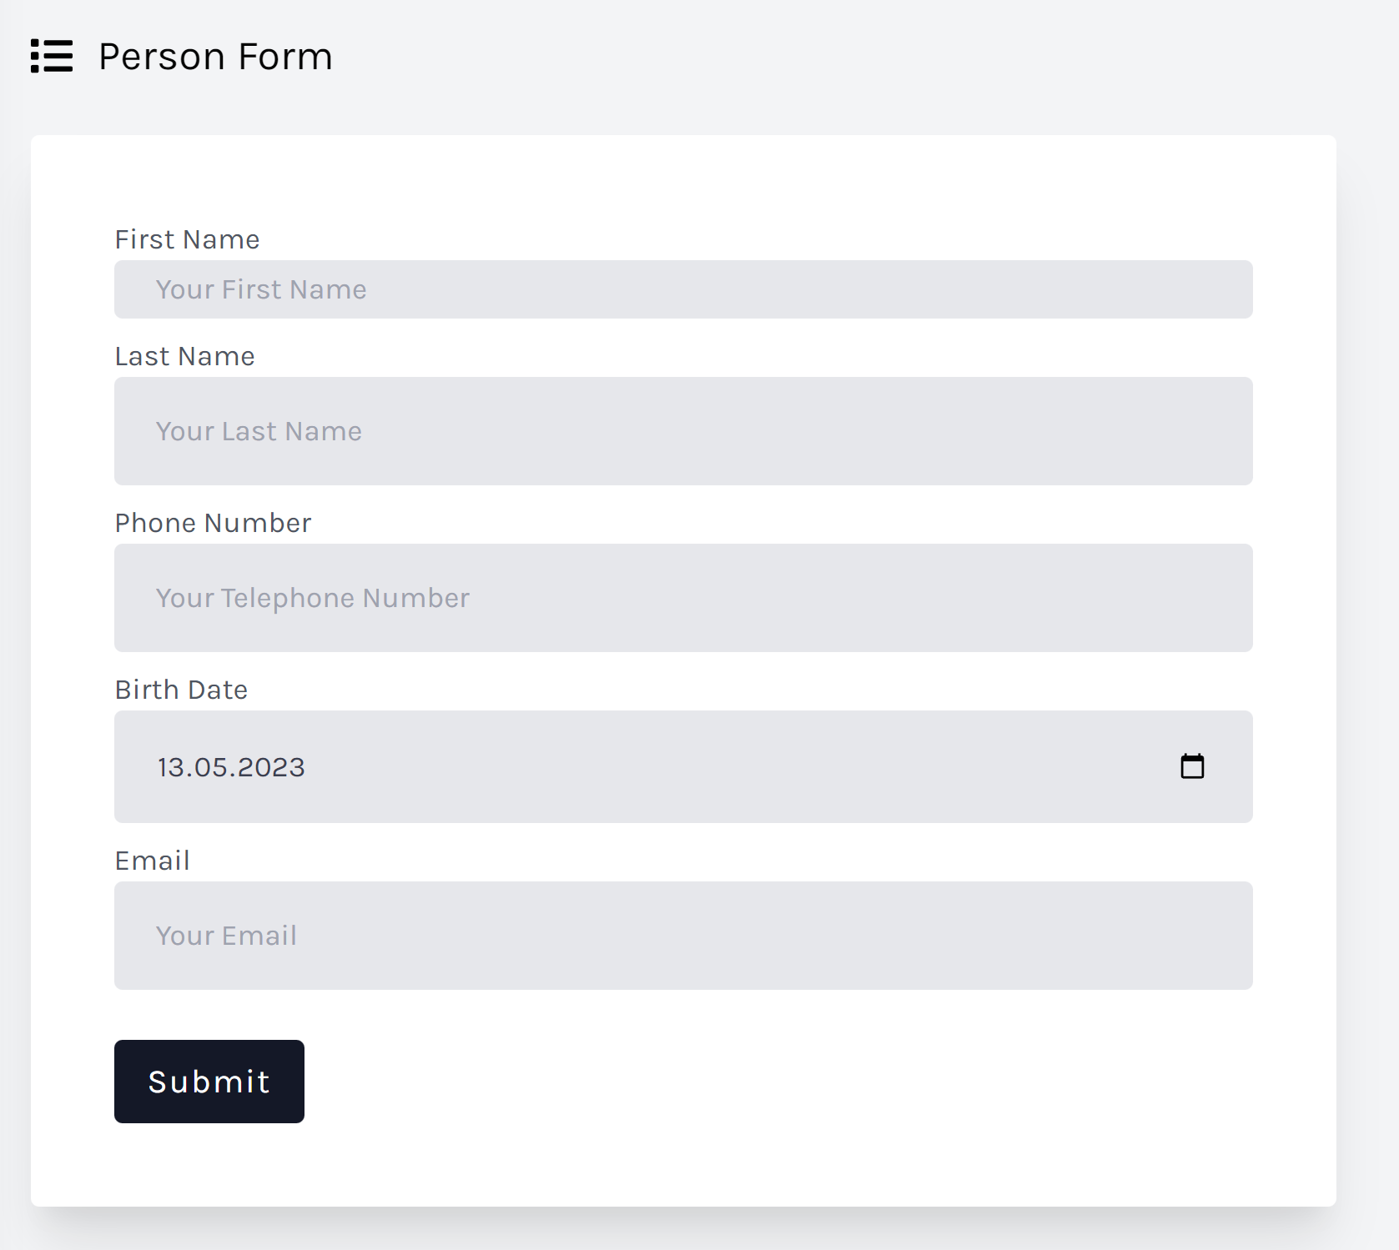
Notes:
Next I will show you how we can leverage Spring ViewComponent to create highly cohesive and loosely coupled features.
In the example use case we want to enable our users to save a person into our database.

Slide 70
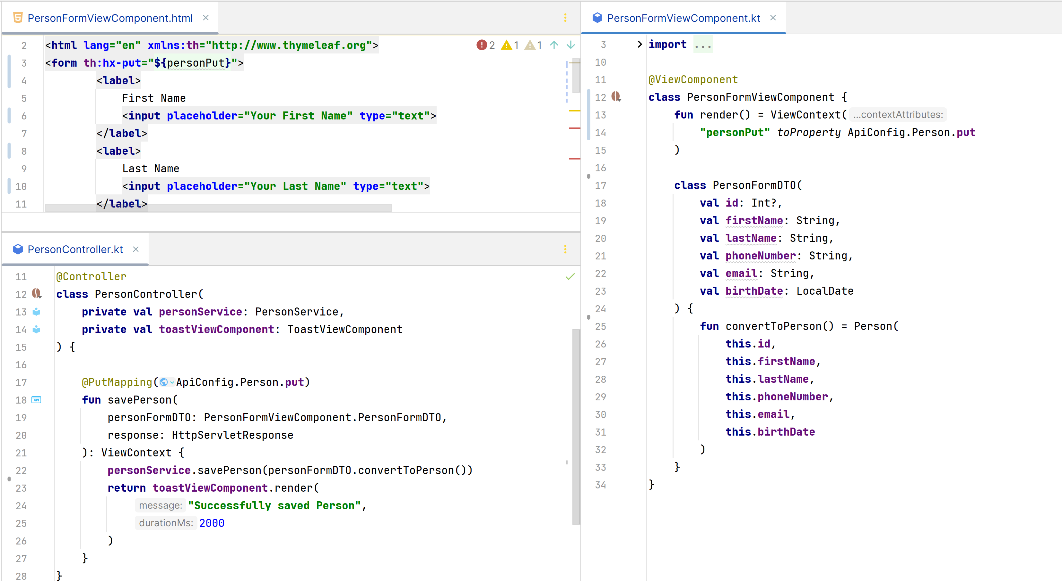
Notes:
On the right you can see our PersonFormViewComponent.
We pass a personPut property from our ApiConfig to our ViewContext. Below that we defined a DTO Class that represents our HTML form you can see on the top left.

Slide 71
Notes:
On the form element you can see that we defined an hx-put attribute with the personPut property as value. Below that we define input fields that match the PersonFormDTO we defined in our ViewComponent Class.

Slide 72
Notes:
In the bottom left panel you can see the PersonController savePerson method that is responsible for saving the person when a user submits the form.
As you can see we reused the ApiConfig in the PutMapping Annotation, thereby externalizing the configuration. We don’t care what path it is, it can change all it want’s our system still works.
We put the personFormDTO as method parameter, meaning we can change the form and dto as much as we want the controller doesn’t care.
Then we save the personFormDTO with the personService, because the DTO offers a conversion method to convert it to the Person Domain object, the dependency points inwards, enabling a clean architecture.
Finally we return a toastViewComponent that will show our User the message that they successfully saved the Person. This is a good example for a reusable parameterized ViewComponent.

Slide 73
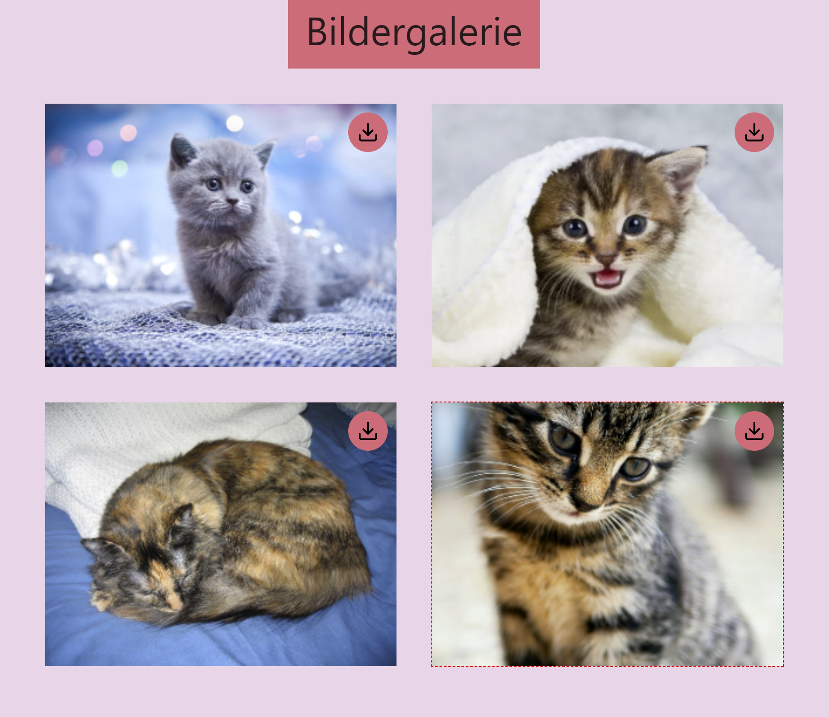
Notes:
For our next use case we want to show some of our favourite cat images in a gallery to our user. Our Images are stored on a S3 Object Storage.

Slide 74
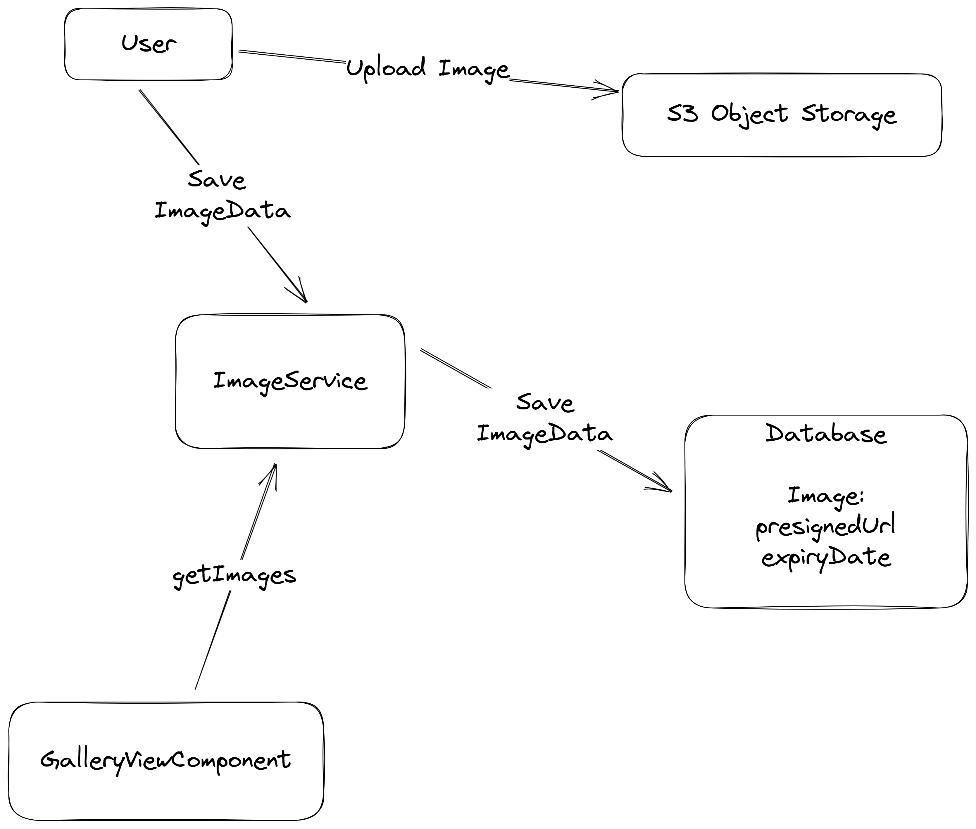
Notes:
The User uploads his favourite cat images directly to the S3 object storage using presigned urls. Then the metadata of that object, including a presigned url to download that image is saved via an ImageService to our Database.
When rendering our GalleryViewComponent we retrieve all presignedUrls from our ImageService. But presigned urls have an expiryDate. Meaning after a maximum of 7 days our link are invalidated. We could refresh our links every 7 days but we want to do that only on demand as this incurs API charges.

Slide 75
Notes:
First we will look one individual image element. This element is rendered with the ImagePreview Component.

Slide 76

ImagePreviewComponent.html
Notes:
In the ImagePreviewComponent Template, we can see how we achieve our on-demand presignedUrl refresh with htmx.
If our image presigned url is expired thymeleaf will render a div with an hx-get to the refresh-preview endpoint that returns the same component but with a new presigned url that is not expired. We swap the whole html of this component by targeting the parent element, with the hx-target attribute.
The beauty comes with the hx-trigger=”revealed” attribute. This means that the refresh request will only be triggered when the html is rendered in the browser window and create the call to the external S3 API.
If our image is not expired it will just display an image element.

Slide 77

Notes:
Next we will take a look at the corresponding Kotlin class. If we call the render method with the refreshImage parameter as false, it will render the preview using the passed imagePreview. If we pass true, the ViewComponent will get the imageData with a refreshed downloadUrl pointing to our S3 object, and return the ViewContext with the refreshed ImageData.

Slide 78
Notes:
The GalleryViewComponent renders the full gallery of cat images.

Slide 79

Notes:
We autowire the imageService and the imagePreviewComponent.
In this use case our gallery images are defined by a subdomain. We get the List of ImageData from the imageService and map it to the list of imagePreview ViewContext objects using the imagePreviewViewComponent render method.
We pass false to the refreshImage parameter as we don’t want to refresh all images at once. Then we pass the imagePreviewList into our ViewContext

Slide 80

GalleryViewComponent.html
Notes:
This is the galleryViewComponent.html that loops over the list of imagePreview ViewContext objects using the thymeleaf th:each attribute and renders them using the view:component attribute.

Slide 81

Notes:
Now we will look at the controller that is used for our gallery. The /galerie endpoint returns the rendered galleryViewComponent, we saw before.
The /galerie/refresh-preview/imageId get mapping returns the imagePreviewViewComponent with the refreshImage parameter set to true.
You can see the typesafe reusability possible with Spring ViewComponent.

Slide 82

Notes:
Finally, here’s the gallery in action!

Slide 83

Notes:
And if we want to further improve the interactivity of our Hypermedia Driven Applications we can use the optional constraint, code on demand of the REST architecture style.
By embedding JavaScript right inside our Components, we enable client side interaction and we satisfy the Locality of Behaviour software design principle.

Slide 84

ToastViewComponent.html
Notes:
Here you can see the HTML of the ToastViewComponent we used earlier.
We embed JavaScript with the script tag, it will automatically be executed when the HTML Snippet is returned by our Server.
In this example we use the setTimeout Function that will set the style dot display attribute of the toast element to none, after the duration we passed with the render method parameter.
Below that we show the message that we passed to the ViewComponent with the th:text attribute.
With the onclick attribute of the button element we enable our users to hide the toast element earlier by clicking on the X.

Slide 85

Notes:
As I’ve just show we can use vanilla JavaScript to enable client side interactivity with Code On Demand.
I’ve really liked the approach of the AlpineJS library. It is a minimal tool to define interactive frontend behaviour directly inside your HTML.

Slide 86

Notes:
I’ve created a sample ViewComponent that shows the power of AlpineJS in combination with Spring ViewComponent.
->
We want to create a TabComponent that we can reuse in our whole application that switches between content client side.

Slide 87

AlpineTabViewComponent.kt
Notes:
We first define a AlpineTabViewComponent.kt that receives a List of Tabs as parameter and then maps the list of tabs to a headerList and contentList.
As you can see the power of the ViewComponent approach, each component can define it’s own api in a typesafe manner.

Slide 88

AlpineTabViewComponent.html
Notes:
Then we define a AlpineTabViewComponent.html that consists of the alpinejs x-data attribute defining a variable scope for this element. We define a openTab variable and set it to zero.

Slide 89
AlpineTabViewComponent.html
Notes:
Now we use the Thymeleaf th:each attribute to repeat the list element for each element in the headerlist.

Slide 90
AlpineTabViewComponent.html
Notes:
We create a button element in each list element and set the text of the button element to the header variable. Then we combine the alpineJs attribute x-on:click, with the thymeleaf element dot index variable. If the user clicks on the button the openTab variable will be set to the index of the element.

Slide 91
AlpineTabViewComponent.html
Notes:
Finally to show the content we define a div that creates a element for each item in the contentList. We will add the alpine x dash show attribute that will toggle the visibility when the headerElement with the same index is selected. Then with th:text we will set the innerHTML to the item of the contentList

Slide 92

Notes:
If we now look at the HTML that is rendered we can see how we combine alpine and thymeleaf together. Thymeleaf creates two list elements with an alpine attribute that selects the active tab. In the content area we can see that the tab that is not selected automatically gets display:none added to it’s style attribute via the x-show alpine directive.

Slide 93

Notes:
But how do we create our web application layout? You could include the header and sidebar in every page, or use the thymeleaf layout dialect, but with Spring ViewComponent it is very simple.

Slide 94


LayoutViewComponent.html
Notes:
We create a Layout ViewComponent, that accepts a ViewContext as parameter and pass that through to the ViewContext constructor in our render method.
As you can see we also accept the activeTab of our sidebar as parameter.

Slide 95


Notes:
This ActiveTab is an enum class in our SidebarViewComponent, that defines the displayName, the icon and the link to our page. For example the Calendar value displays Calendar, the fontawesome calendar icon and links to the /calendar page.

Slide 96
Notes:
We pass the activeTab and the values of our enum to the SidbarViewComponent ViewContext

Slide 97
Notes:
In our SidebarViewComponent Template we loop over the activeTabsArray and create an anchor elemtn for each. For the activeTabe we add active-nav-link css class with the th:classappend attribute. For all others we add a opacity of 75 percent.
We also add the fontawesome icon class for each icon and show the displayname in the span element.

Slide 98

Notes:
Finally we can use the layoutViewComponent in our Controller.
To do that we just call the layoutViewComponent.render method you see at the top and pass the ActiveTab Enum Value and the nested ViewComponent as parameters.
As you can see the GetMapping Annotation also uses the SidebarViewComponent dashboardHref.

Slide 99

Notes:
The next step is to integrate Spring ViewComponent and HTMX and enable Spring as a full-stack web framework and get the developer experience up to par with other full-stack web frameworks.

Slide 100


Notes:
This is where Spring ViewAction comes in.
It is essentially a postprocessor that connects your ViewComponent with their templates using htmx.
You can define a method inside your ViewComponent and annotate it with a ViewAction annotation corresponding to a HTTP Method and return the render method call.
Then in your template you reference the method name inside a view:action attribute

Slide 101


Notes:
This attribute in the template get’s transformed to htmx attributes, that will create a request to a generated controller endpoint and swap the whole ViewComponent.

Slide 102


Notes:
Spring ViewAction makes it easy to create something more complex like a todo list.
On the left you can see the ActionViewComponent that passes a itemList from the exampleService into it’s ViewContext.
On the right you see the template creating a div element for each item in the list and a span inside with the item value as text.

Slide 103
Notes:
We create a new item with a PostViewAction to a customPath we can define inside the Annotation Constructor, handy if we want to restrict the access for example.
In this method we call the exampleService.addItemToList method and return with a call to the render method.
In the template you can see that we reference the addItem method inside our form element that has a text input.

Slide 105

fullstack.tschuehly.de

Slide 106


Slide 107

github.com/tschuehly/supabase-security-spring-boot-starter

Slide 108


